Slide 1
Acid/Base Chemistry
Chemistry

Slide 2
Acids vs Bases
Definition | Acid | Base
Arhennius | H⁺ excess | OH^{-‑} excess
Bronsted-Lowry | proton donor | proton acceptor
Lewis | electron pair acceptor | electron pair donor
Ex BF₃ + NH₃ reaction

Slide 3
Types of Reactions for Acids
General | Example
Metal + acid → H₂ + salt
Acid + base → salt + water
Acid + metal oxide → salt + water
Acid + carbonate → salt + water + CO₂

Slide 4
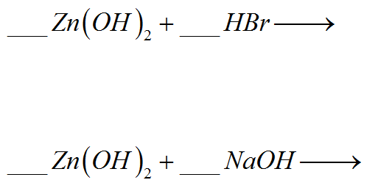
Amphoteric Hydroxides and Base Reactions
Hydroxides can act as both acids and bases
referred to as amphoteric
Ex Zinc Hydroxide reactions (name each reactant, product, and type of reaction)

Slide 5
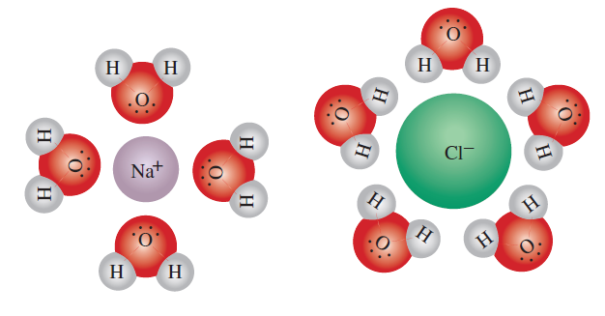
Ionization in Water
Electrolytes: ions dissociated in water
Classified as “strong” or weak”
If substance does NOT conduct electricity in water when dissolved in water, then nonelectrolytes
Typical electrolytes are: salts, acids, & bases
When dissolved, salts separate into cations and anions
Water molecules surround based on charge
Ex How many ions result from the solution of 2mol of the following in water?
a) lithium nitrate b) calcium chloride

Slide 6
Strength of Acids and Bases
STRONG ACID/BASE: completely dissociates in water
- the concentration of that solution is the concentration of ion in that solution
WEAK ACID/BASE: incomplete dissociation in water
bad proton donor/acceptor
bad electron pair acceptor/donor
Ex Given 3M HCl, a strong acid, we can tell that:

Slide 7
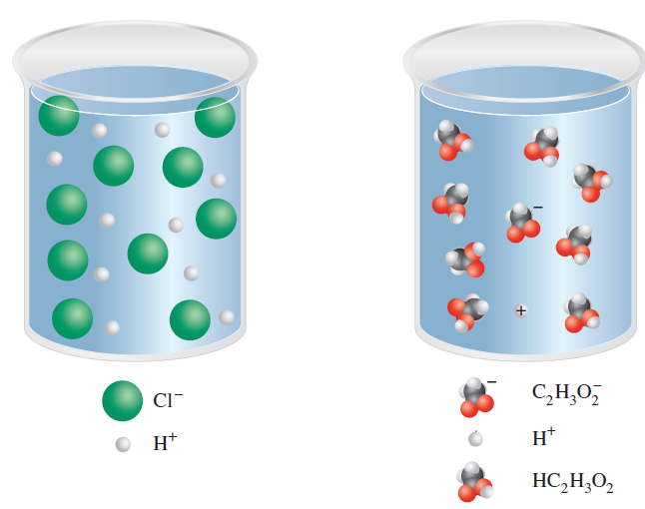
Strength of Acids and Bases

Slide 8
Water and the hydronium ion
water is a polar molecule
water molecules are individually held together by covalent bonds
they connect to adjacent water molecules by hydrogen bonds
water in liquid solution, water undergoes autoionization

Slide 9
Water and the hydronium ion
at room temperature, the equilibrium concentrations have been shown to be:
The equilibrium constant of this reaction is:
Acidic | Basic | Neutral

Slide 10
The pH scale
acid/base concentrations tend to be very small in normal solutions (between 0M and 1M)
instead of expressing concentrations in scientific notation, we use the pH scale:
Ex What is the pH of a solution with concentration:

Slide 11
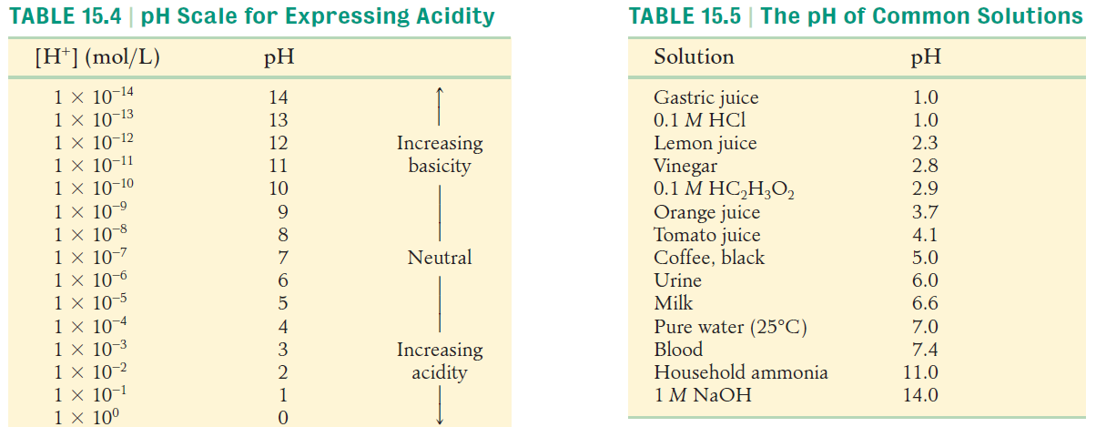
The pH scale

Slide 12
The pH scale
Usually pH is between 0 and 14
very strong acids can have pH below 0
very strong bases can have pH above 14
Ex 16M HCl
We may also solve [H⁺] using the definition of a log:
Ex pH = 2.1 ; what is the [H⁺]?

Slide 13
The pH scale
To solve either [OH⁻] or [H⁺], use the K_{w} equation:
a) [OH⁻] = .066 ; solve [H⁺].
b) Find [OH⁻] and [H⁺] for 12M NaOH.

Slide 14
Naming Acids and Bases
we can generally say acids have hydrogen as the leading element
for these, we can use the ionic form of hydrogen, H⁺
thus, we need as many hydrogens as necessary to balance the charge
there are two naming schemes, depending on your anion:
Elemental Anion: “hydro- -ic acid”
Polyatomic Anions: ”-ate” => “ -ic acid” ”-ite” => “ -ous acid”
Ex Name the acids
a) H₂S b) H₃PO₄ c) HNO₃

Slide 15
Naming Acids and Bases
Most common bases contain the hydroxide ion, but the Arrhenius definition allows many other bases in solution
Ex Name the following bases.
a) KOH b) Na₂CO₃ c) NH₃
You should know the following common acids/bases:
HCl, HNO₃, H₂SO₄, HC₂H₃O₂
NaOH, KOH, NH₃

Slide 16
Conjugates
when acids break apart, you are left with the conjugate part
usually, the conjugate of…
an acid simply loses a H⁺ (this is the conjugate base)
a base simply loses the OH⁻ (this is the conjugate acid)

Slide 17
Polyprotic acids
acids with more than one proton
these may have multiple stable conjugate bases
Ex Write the conjugate bases and name them.
a) HClO
b) H₂SO₄
c) H₃PO₄

Slide 18
Neutralization and Net Ionic Equations
reaction between an acid and base to form Salt & water
this brings your pH closer to 7 (neutral)
- it is best to write the net ionic equation to simplify what happens in neutralization
- we remove all spectator ions
ions present in reaction, but that do not react

Slide 19
Net Ionic Equations
Show the net ionic equation for each acid/base reaction.
a) hydrochloric acid and sodium hydroxide
b) acetic acid and calcium hydroxide

Slide 20
Net Ionic Equations
Show the net ionic equation for each reaction.
a) magnesium in hydrochloric acid
b) sodium carbonate and sulfuric acid

Slide 21
Titrations
method of gradually changing pH of a solution in order to find the concentration of an unknown
often we look for when the acid and base amount balance each other out
this is called the equivalence point
titrations require a VERY accurately measured standard solution
that is, an accurate and precise balance (weighing) and liquid dilution
the most accurate glassware to use is a buret
most often we use a color indicator to show the endpoint of titration
the most common is phenolphthalein
titration requires matching number of moles of acid to number of moles of base

Slide 22
Titration
titration requires matching number of moles of acid to number of moles of base
we use the titration formula: M_{A}V_{A} = M_{B}V_{b}
Ex We find that 21.5mL of a 0.100M HCl standard solution titrated 50mL of NH₄OH. Find the concentration of ammonium hydroxide.

Slide 23
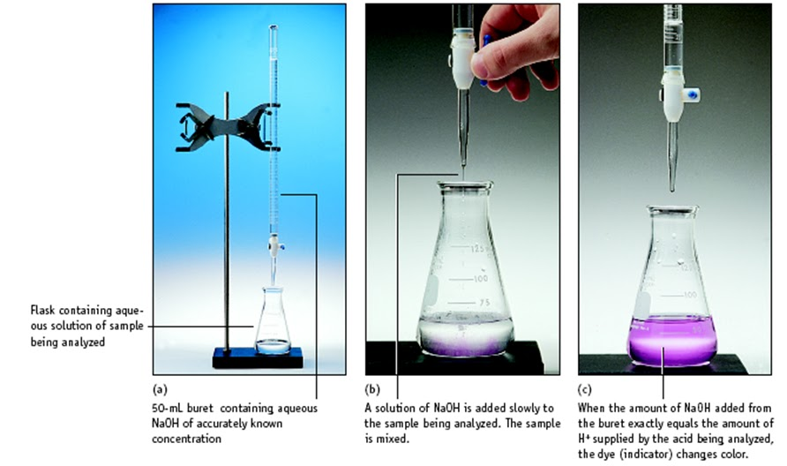
Titration

