Slide 1
Introduction to Quantum Mechanics
Chemistry

Slide 2
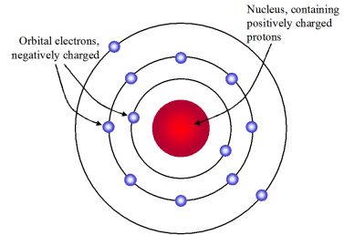
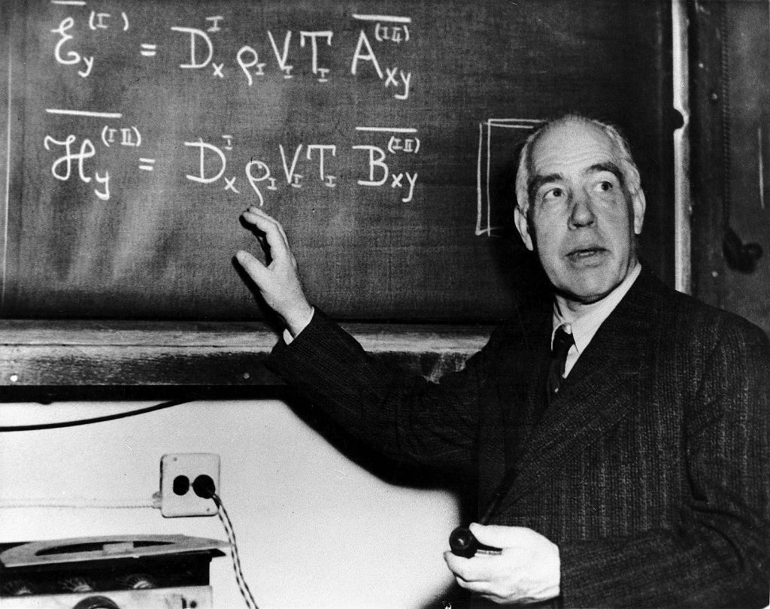
Electron Orbitals
First proposed by Niels Bohr
Probability density of where an electron can be found 90% of the time
no certainty where it is!
Works on all Hydrogen-like atoms

Slide 3
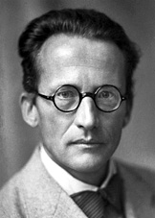
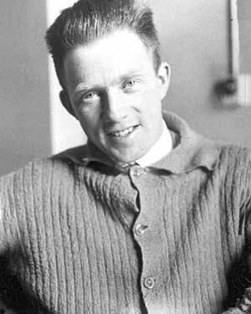
Mathematical Models
Werner Heisenberg proposed a wave-particle duality
This allowed electrons to be modelled like light
Erwin von Schrödinger later modelled these waves mathematically
Defined electron clouds

Slide 4
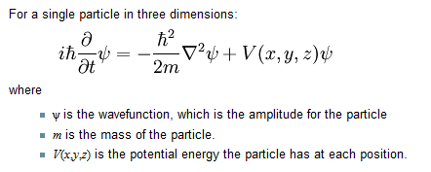
Equations

Slide 5
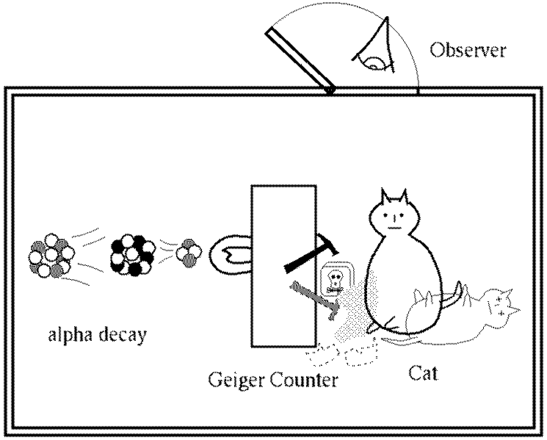
Schrodinger’s Cat

Slide 6
Schrodinger’s Cat

Slide 7
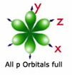
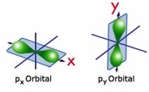
Electron Orbitals: s & p
The orbital is where the electron resides 90%of the time
generally we talk about the s and p orbitals
s has one configuration
p has three configurations

Slide 8
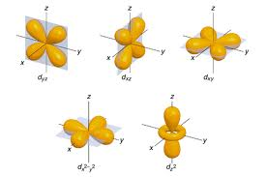
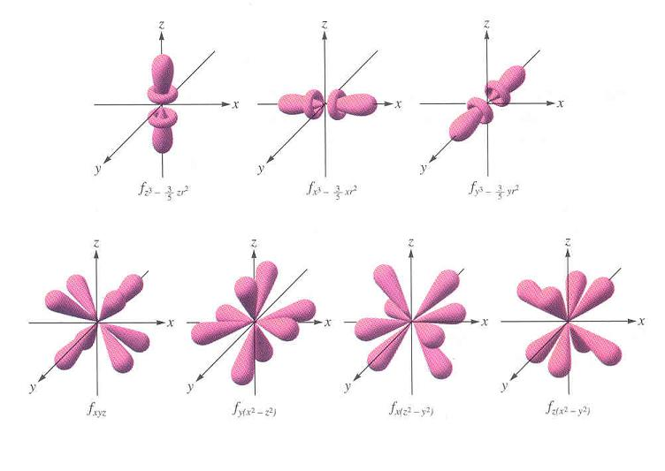
More orbitals
There also d and f orbitals, but these are more complex

Slide 9
Quantum Numbers
The physics branch quantum mechanics is the field governing the motion of electrons
Unlike matter, electrons may only exist in one state or another, but not in between
quantum numbers determine the number and type of orbitals
Three basic rules:
Pauli Principal
“Aufbau” Principal
Hund’s Rule

Slide 10
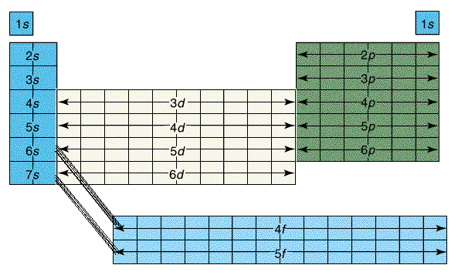
Periodic Table Blocks
These indicate the orbitals where the individual electrons reside
generally they are configured by row on the periodic table, and orbital type
remember the number of lobes, and each can hold two electrons
The periodic table can generally be broken down to the following orbital blocks:

Slide 11
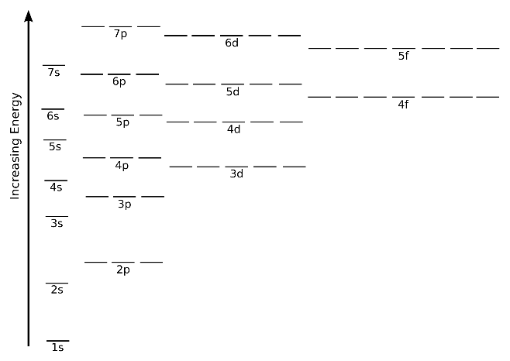
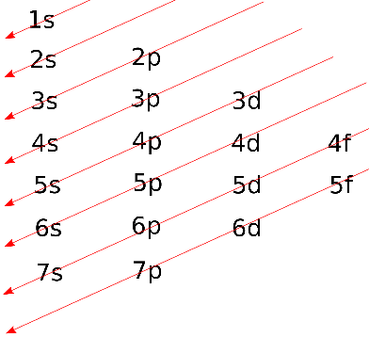
Orbital Energies

Slide 12
Electron Configurations
Ex Write the full electron configuration.
H
Be
F
Na
Si
V
Cd

Slide 13
Abbrev. Configurations
We can abbreviate the electron configurations using noble gas notation
to do this, start at the noble gas just before that period
Ex Write the electron configuration in abbreviated form.
Na
S
Sr
Co
Nd
At

Slide 14
Orbital Diagrams
Same as electron configurations, but they represent orbitals as boxes
they show the Pauli principal with spins of up or down
also show Hund’s Rule as half filled orbitals

Slide 15
Ex Use orbital diagrams to represent the electrons of each atom.
Li
O
Si
Ar
Ni
Br

Slide 16
Quantized energy
Neils Bohr found that electrons could move from one orbital to the next
Required a specific quantityof energy
Does not work with less or more energy
In this sense, orbital energies are quantized
Definite energies

Slide 17
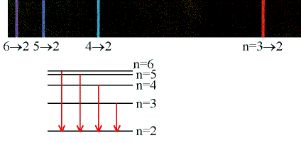
Ground vs Excited States
Electrons in most stable, low energy state are said to be in ground state
These can “jump” to an excited state by adding energy
Usually heat or electricity
Once raised to a higher energy, electrons will “fall” back down to ground state
To do this, a photon of light is released

Slide 18
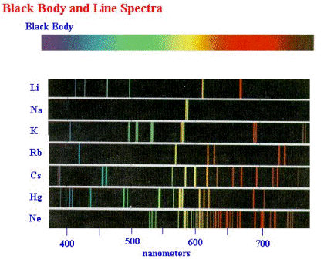
Emission Spectrum
Every pure gas has a characteristic emission spectrum
This represents many electrons excited by high voltage electric power

Slide 19
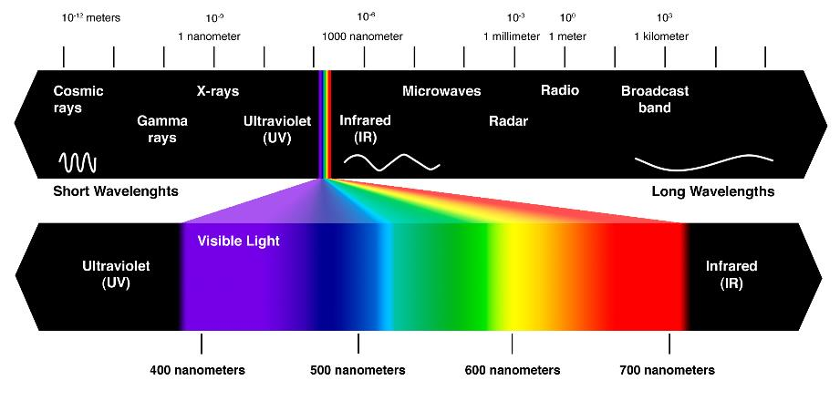
Light Spectrum
Light comes in many forms:

Slide 20
Light energy
The speed of light is known to be: c = 3.00 x 10⁸ m/s
We can relate wave speed to wavelength and frequency:
c = λν λ = wavelength (m) ν = frequency (Hz, or s⁻¹)
The energy of a photon can then be calculated:
E = hν = hc/ λ h = Planck’s constant = 6.26 x 10⁻³⁴ m²-kg/s

Slide 21
Ex Choose two spectral lines for helium and calculate their energies.
First, identify wavelengths (given):
Now plug into the equation; let’s calculate just one:
E = hν = hc/ λ

Slide 22
End

