Slide 1
Chemistry
Ideal Gases

Slide 2
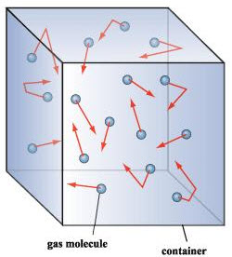
The Kinetic Theory of Gases
An ideal gas is said to have the following characteristics:
Very small particles with relatively large mean free paths
thus few collisions with other gas particles & walls
Perfectly elastic collisions with particles and wall
No “sticky” forces at all
Kinetic energy is directly proportional to temperature
As particles heat up, they move faster

Slide 3
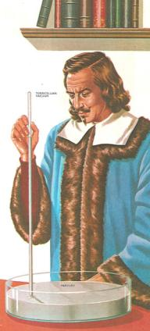
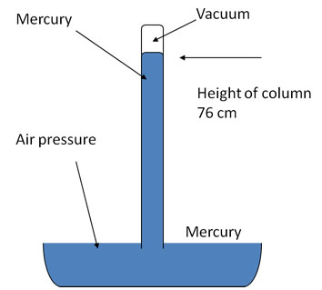
Gas Measurements
gases are nearly impossible to quantify with mass or volume
Gases expand and are not confined in space
- 1640s, Italian physicist/mathematician Evangelista Torricelli
invents a simple barometer using an inverted tube of mercury

Slide 4
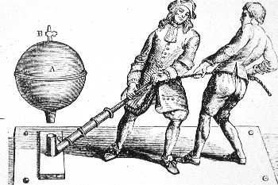
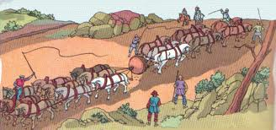
Otto von Guericke
1650s, the German scientist Otto von Guericke invented the vacuum pump
famous demonstration had horses pull two empty hemispheres
repeated for Friederich Wilhelm I

Slide 5
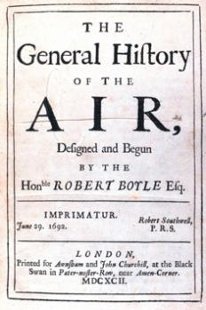
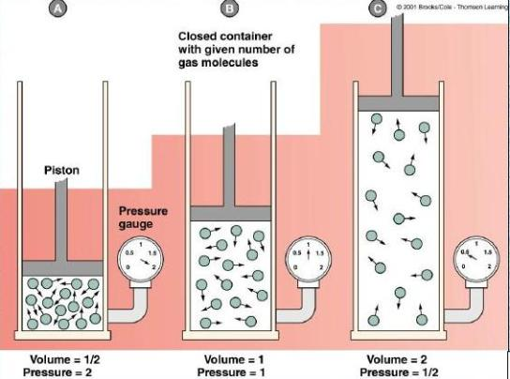
Boyle’s Law
Irish scientist Robert Boyle invented a barometer using mercury
under “normal” conditions, the height was 760mm
weather would change the reading
http://ch301.cm.utexas.edu/flash/boyles_law_graph.swf

Slide 6
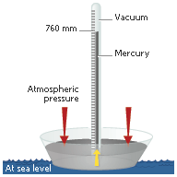
Standard Pressure Measurements
Pressure is the standard measurement for gases
in chemistry, the most common unit is the atmospheres
or atm
practical applications use the pound per square inch, or psi
In physics, the SI unit is the Pascal
but most measurements are in Mpa, kPa
the short form that is nearly an atmosphere is the bar: 101300Pa
Standard Temperature and Pressure, or STP is defined scientifically as:
1atm @ 273K (0°C)

Slide 7
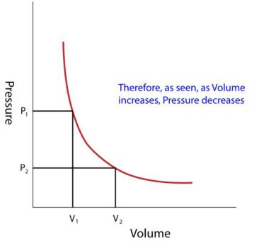
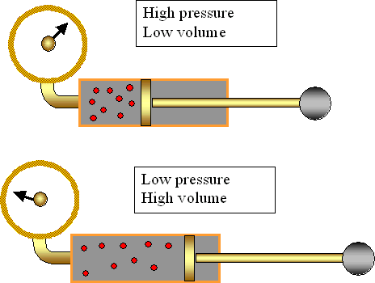
Boyle’s Law
Robert Boyle found the relationship between pressure and gas volume:

Slide 8
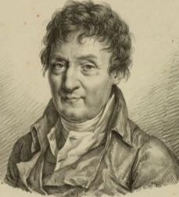
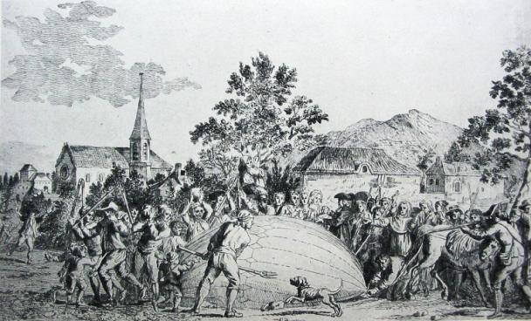
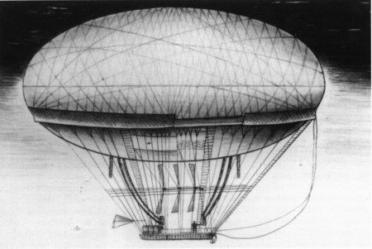
Charles’s Law
Jacques Charles studied expansion of gases
Invented the first hot air balloons

Slide 9
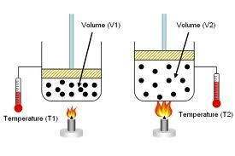
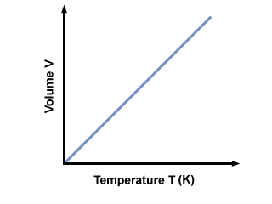
Charles’s Law
As gases heat up, they can expand:

Slide 10
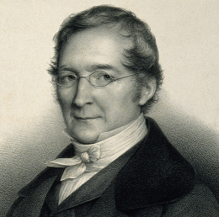
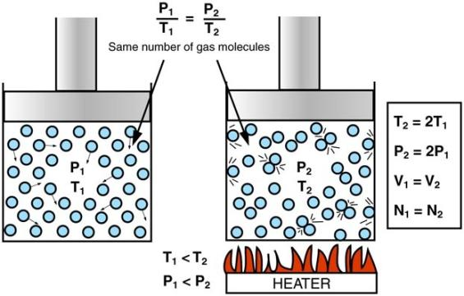
Gay-Lussac’s Law
Studied relationship of pressure vs temperature
Published his work, and credited Jacques Charles for Volume/Temperature relationship
Found that pressure and temperature are directly proportional:

Slide 11
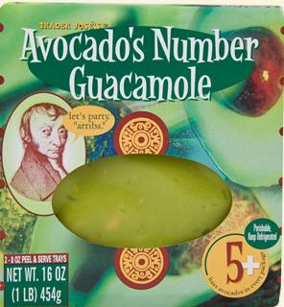
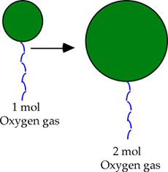
Avogadro’s Law
Very simple relationship: adding gas molecules causes expansion

Slide 12
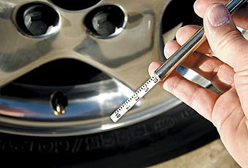
Tire pressure
A tire on the road is inflated to 45psi at 22°C. While driving, friction heats it to 120C. Since the tire cannot expand, calculate the final pressure.

Slide 13
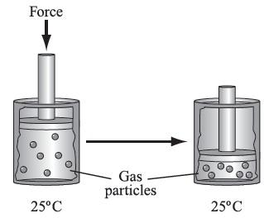
Piston
A piston is compressed at standard atmospheric pressure and a volume of 40.mL down to a volume of 5.0mL. Calculate the pressure at this volume.

Slide 14
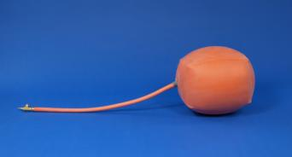
Inflatable device
An inflatable bladder holds 4.8mol of a gas at a volume of 2.2L. Calculate the number of moles required for it to reach 6.0L.

Slide 15
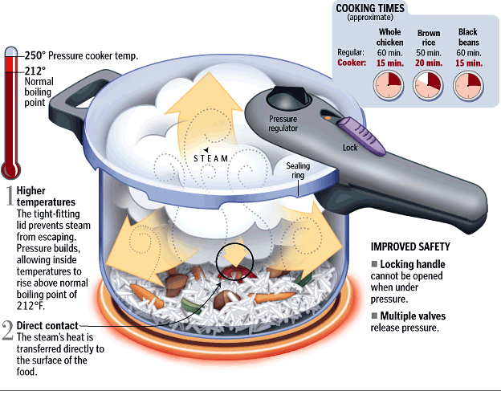
Pressure cooking
A pressure cooker has 2.5L of space to hold a gas. It is initially at 1.1atm when held at room temperature of 25°. Water is allowed to boil, raising the gas temperature. Calculate the new pressure in the cooker.

Slide 16
The Combined Gas Law
We can combine all of our gas laws into one equation
this can be used for any of these types of problems
variables that are held constant are unnecessary on either side of the equation
quantities that change are necessary and should be kept

Slide 17
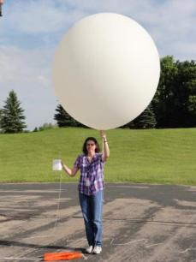
Atmospheric pressure
The volume of a weather balloon is 8.0m³ at 310K on the ground. As it rises, the temperature drops to 220K, the volume of the balloon increases to 12m².
a) Calculate the pressure of the balloon at this height.
b) Using the physical relationship P = P_{atm} + dgh, calculate the height; here, g = 10m/s², the acceleration due to gravity.

Slide 18
Sealed tank
A sealed tank of volume 0.10m³ contains air at 27°C° under 18kPa of pressure. The valve can withstand 50kPa of pressure. a) What is the maximum temperature of this gas without releasing any? b) Suppose you needed to raise the temperature to that in part (a) but maintain a pressure of 18kPa; how much of the gas must you release?

Slide 19
Helium tank
A clown brings a helium tank to a party. When full, each balloon is a sphere of radius 35cm. The tank is a cylinder at a pressure of 16MPa, and it has a height of 1.3m and radius of 0.22cm. Calculate the number of balloons he can fill.

Slide 20
Ideal Gas Law
- we can combine all of the gas laws, leaving one side constant to arrive at the Ideal Gas Law:
the constant R comes from the fact that this is proven using statistical mechanics
it is the Boltzmann constant multiplied by Avogadro’s number

Slide 21
Ideal Gas 1
A hot air balloon runs at 380°C. It holds 50.kg of helium, and flies where the pressure is only 0.86atm. Calculate the volume of the balloon.

Slide 22
Ideal Gas 2
A 145L water tank at 29°C and 736torr is “empty”. How many moles of air are in it?

Slide 23
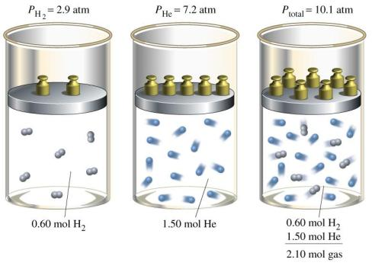
Dalton’s Law of Partial Pressures
When gases mix, their pressures add to give a total pressure
in this sense, the contribution from each gas is only a partial pressure
Dalton’s Law of Partial Pressures

Slide 24
Partial Pressure 1
On a hot and humid day, the air is composed of 13% water vapor, 16% oxygen, and the rest is nitrogen at sea level (760 torr). Calculate the partial pressures of each gas.

Slide 25
Partial Pressure 2
Dry air is composed of 78%N, 21%O, and 1% Ar. A 20.L sample of air is taken on a hot (37°C) day. The atmospheric pressure is 770torr. Calculate the total number of moles in the sample, and the number of moles of each gas taken.

Slide 26
Density
- we can use some simple stoichiometry in the Ideal Gas law to solve for the density of any gas based on molecular weight
Example:
The density of air is 1.29g/L at STP. Calculate the theoretical molar mass of air.

Slide 27
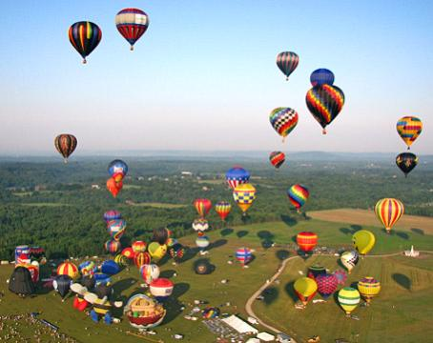
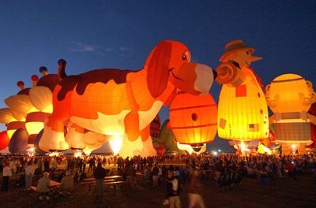
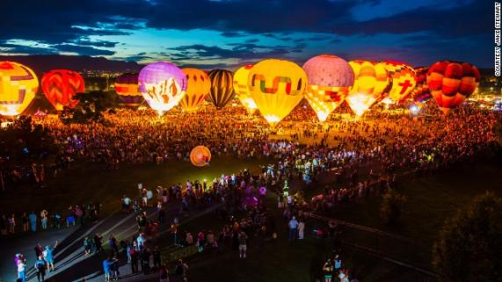
Done with Gases

