Slide 1
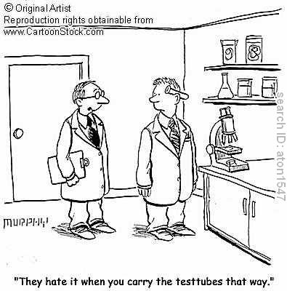
Lab Safety
Chemistry

Slide 2
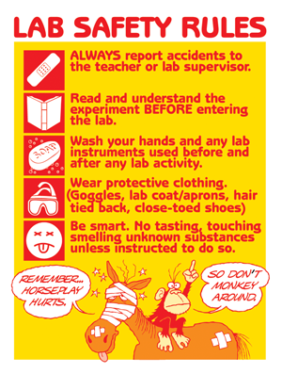
Lab Safety
Personal protective equipment is important!
Rely on lab partners
Know the lab area

Slide 3
Partner Time!!
Which of these lab safety rules do you think is the most important?

Slide 4
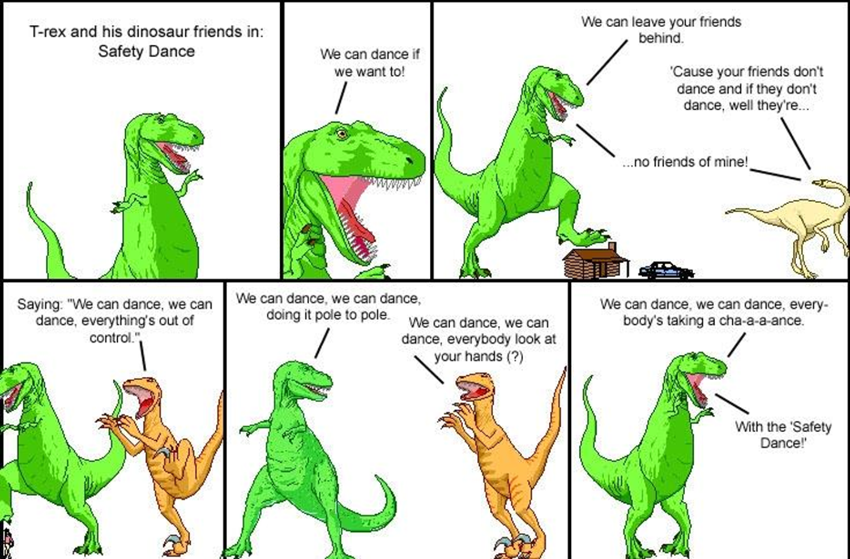

Slide 5
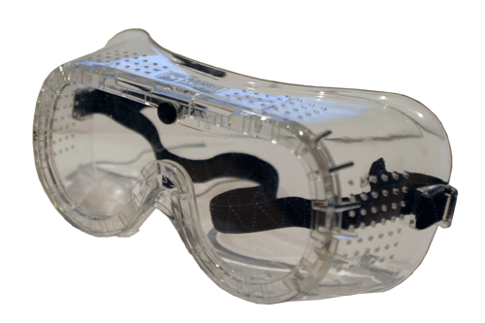
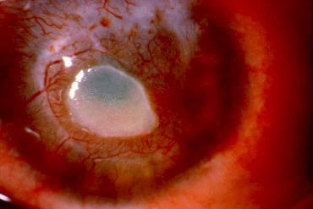
Safety goggles
Always wear goggles in lab
Eyeglasses are not a substitute
Contact lenses acceptable
Notify instructor

Slide 6
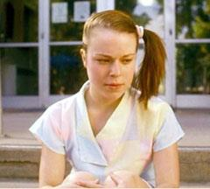
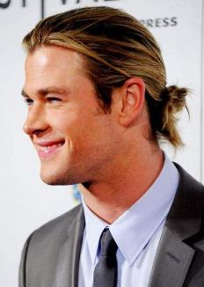
Tie back long hair
Keep hair up and away from chemicals/burners
Keep hair out of your eyes

Slide 7
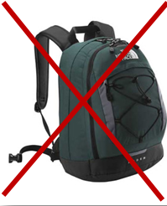
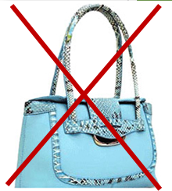
No No No…
Backpacks
Purses
Unnecessary devices

Slide 8
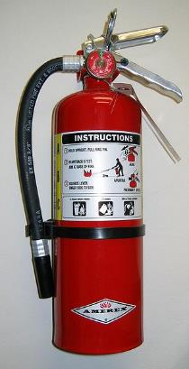
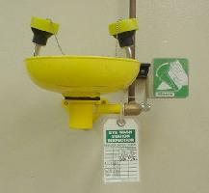
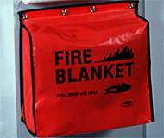
Know locations of…
Exits
Eyewash/Shower
Fire blanket
Fire extinguishers

Slide 9
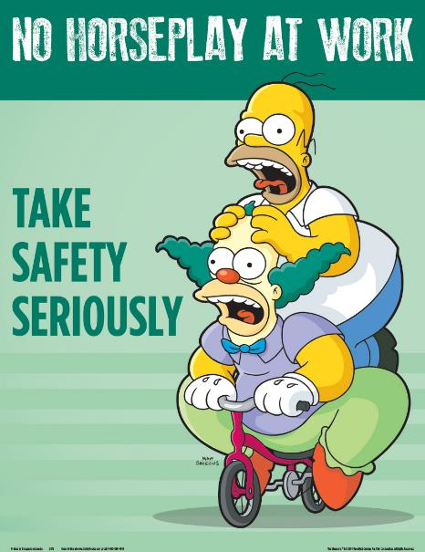
Behavior
You may be dismissed from lab for any potentially dangerous behavior
Horseplay
Texting/Pictures
Gaming

Slide 10
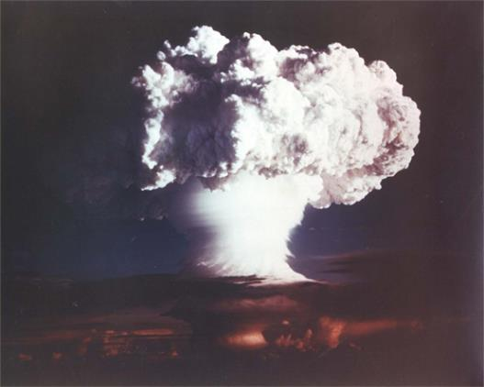
No unauthorized experiments
Only work on assigned lab during lab time
Ask if further experiments are needed or warranted

Slide 11
No food/drink

Slide 12
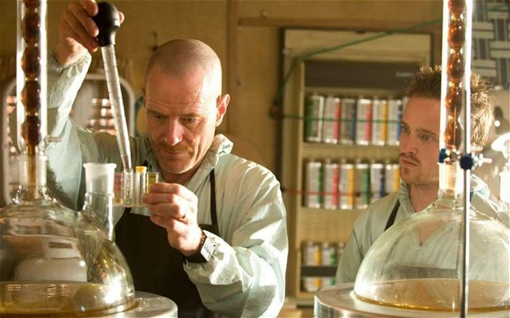
Never remove chemicals from lab

Slide 13
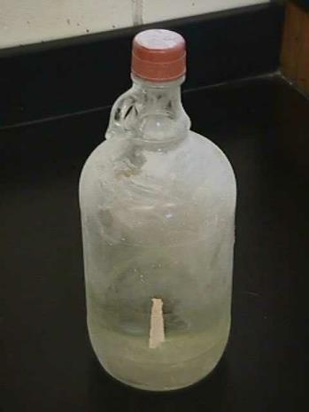
Unlabeled container
Never use chemicals from an unlabeled container
WHY?

Slide 14
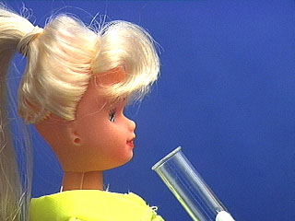
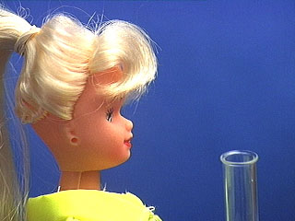
Title
NEVER point the mouth of a test tube or Erlenmeyer flask at yourself or another person!
ALWAYS direct the mouth away from people

Slide 15
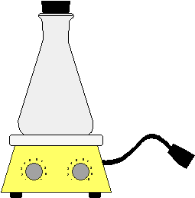
Never Heat a Closed Container
The increasing pressure in the container can cause the contents to spray out the top, or the container shatters, spreading shards of glass

Slide 16
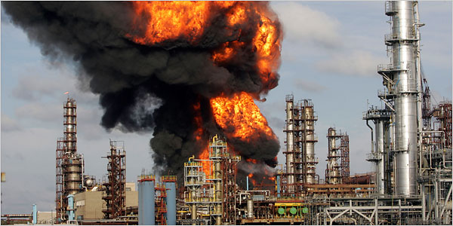
Keep Flammable Substances Away From Heat Sources

Slide 17
What if you spill something? What do you think you should do first?
Brainstrom with your partner

Slide 18
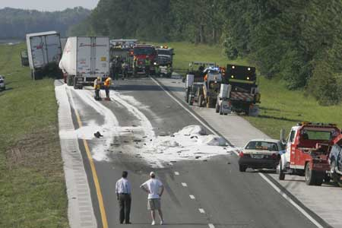
Clean up all spills immediately
Never return spilled or unused material to the reagent bottle.
Solids should be swept up and placed in the waste disposal container for that lab
Small liquid spills should be diluted with lots of water and mopped up with a cloth towel.
Large spills must be handled by the instructor.

Slide 19
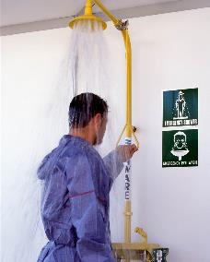
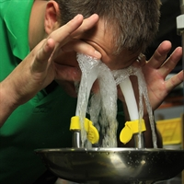
First Aid
Alert the instructor
If chemicals have come in contact with the eyes, begin eyewashing NOW!
Remove clothes that have chemical contamination
Move everyone away from the area to avoid further contamination
Report all injuries to your instructor immediately.

Slide 20
Lab Equipment
Used for measurements of:
Volume
Temperature
Used for transferring chemicals
Heating/Cooling safely

Slide 21
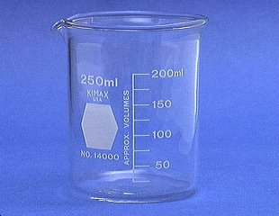
Beakers
Beakers hold solids or liquids that will not release gases when reacted or are unlikely to splatter if stirred or heated.
Scenario: Student #A is so thirsty and forgot his water bottle at school. He thoroughly cleans the beaker and proceeds to use it drink some water from the sink. WHAT IS WRONG HERE!

Slide 22
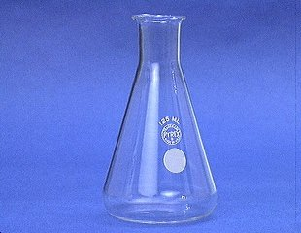
Erlenmeyer flask
Erlenmeyer flasks hold solids or liquids that may release gases during a reaction or that are likely to splatter if stirred or heated.

Slide 23
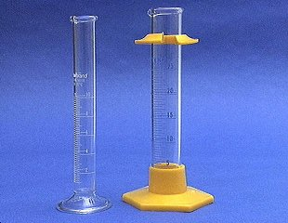
Graduated cylinder
A graduated cylinder is used to measure volumes of liquids.

Slide 24
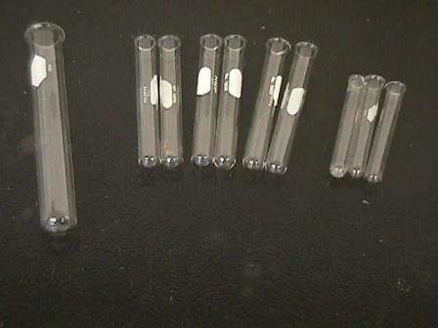
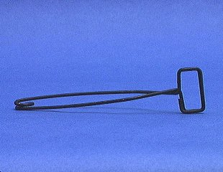
Test tubes
Test qualitative reactions
Large test tubes to collect gas
Ignition tests
A test tube holder is useful for holding a test tube which is too hot to handle.

Slide 25
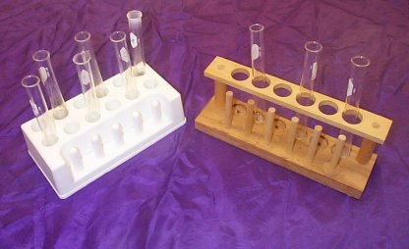
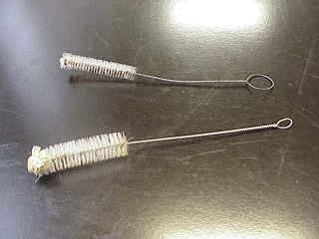
Test tube maintenance
Test tube brushes are used to clean test tubes and graduated cylinders
Forcing a large brush into a small test tube will often break the tube.
Test tube racks are for holding and organizing test tubes on the laboratory counter.
Plastic racks may melt in contact with very hot test tubes.

Slide 26
What can you put in a test tube?
Illustrate your ideas and share it with a partner

Slide 27
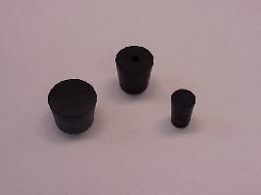
Stoppers
Rubber stoppers are used to close containers to avoid spillage or contamination.
Containers should never be heated when there is a stopper in place.

Slide 28
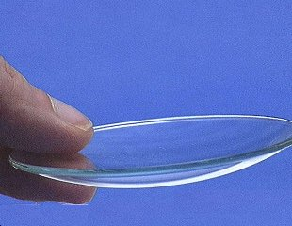
Watch glass
A watch glass is used to hold a small amount of solid, such as the product of a reaction.
Can be used for drying
Name comes from watches

Slide 29
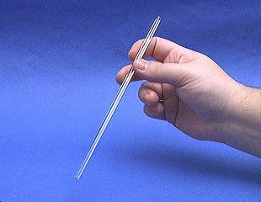
Glass Stir rod
A glass rod is used to manually stir solutions.
It can also be used to transfer a single drop of a solution.
Acid/base chemistry

Slide 30
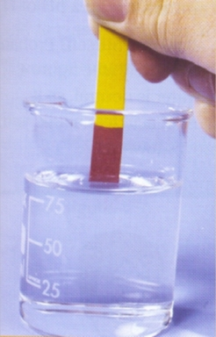
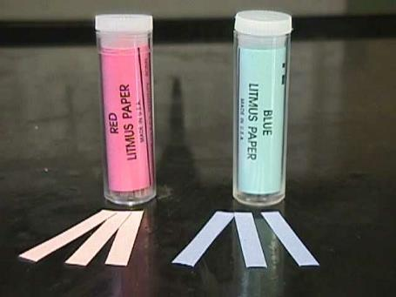
pH paper
Red litmus paper is used to identify bases.
Blue litmus paper is used to identify acids.
pH paper can be used to identify pH of a solution

Slide 31
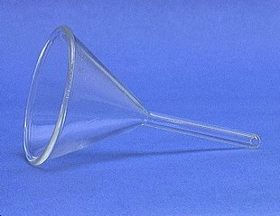
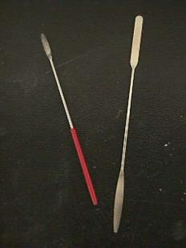
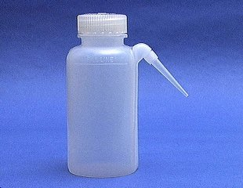
Miscellaneous equipment
A funnel is used to aid in the transfer of liquid from one vessel to another.
A wash bottle has a spout that delivers a wash solution to a specific area. Distilled water is the only liquid that should be used in a wash bottle
Spatulas are used to dispense solid chemicals from their containers.

Slide 32
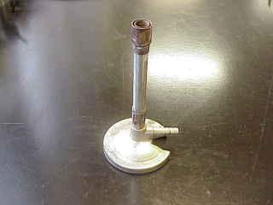
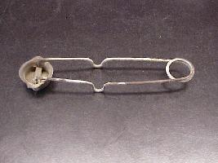
Hot Equipment
Bunsen burners are used for the heating of nonvolatile liquids and solids.
Strikers are used to light Bunsen burners.
The flints on strikers are expensive. Do not operate the striker repeatedly just to see the sparks!

Slide 33
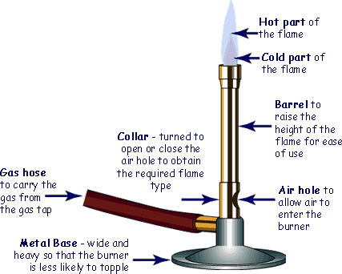
Hot Equipment

Slide 34
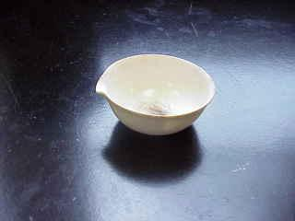
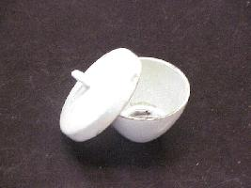
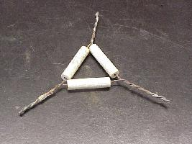
Hot Equipment
The evaporating dish is used for the heating of stable solid compounds and elements.
Crucibles are used for heating certain solids, particularly metals, to very high temperatures.
The clay triangle is used as a support for porcelein crucibles when being heated over a Bunsen burner.

Slide 35
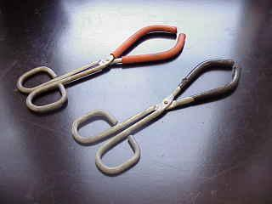
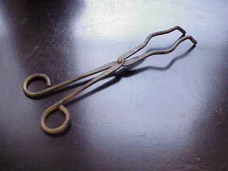
Tongs
Beaker tongs are used to move beakers containing hot liquids
Crucible tongs are for handling hot crucibles; also used to pick up other hot objects. NOT to be used for picking up beakers!

Slide 36
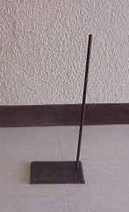
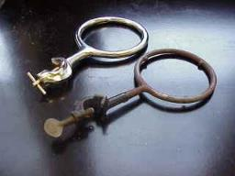
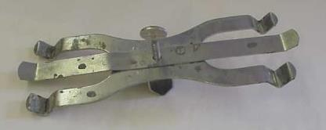
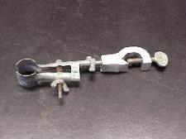
Ring stands
Ringstands are a safe and convenient way to perform reactions that require heating using a Bunsen burner.
Iron rings connect to a ringstand and provide a stable, elevated platform for the reaction.
Utility clamps are used to secure test tubes, distillation columns, and burets to the ringstand
Double Buret clamps are used to burets – long graduated tubes used in titration.

Slide 37
Lab Safety Video

Slide 38
Agenda
Lab question
Finish glassware slides
Measurement (reading)
Stations Activity
Kahoot (graded)
Use your name or initials

Slide 39
Question
Discuss with your partner:
What is one question/issue/scenario NOT addressed by the Flinn Lab Safety Contract or the Crash Course Chemistry video?

Slide 40
Measuring
Volume
Temperature
Mass

Slide 41
Reading the Meniscus
Always read volume from the bottom of the meniscus. The meniscus is the curved surface of a liquid in a narrow cylindrical container.

Slide 42
Try to avoid parallax errors.
Parallax errors arise when a meniscus or needle is viewed from an angle rather than from straight-on at eye level.
Incorrect: viewing the meniscus from an angle
Correct: Viewing the meniscus at eye level

Slide 43
Graduated Cylinders
The glass cylinder has etched marks to indicate volumes, a pouring lip, and quite often, a plastic bumper to prevent breakage.

Slide 44
Measuring Volume
Determine the volume contained in a graduated cylinder by reading the bottom of the meniscus at eye level.
Read the volume using all certain digits and one uncertain digit.
Certain digits are determined from the calibration marks on the cylinder.
The uncertain digit (the last digit of the reading) is estimated.

Slide 45
Use the graduations to find all certain digits
There are two unlabeled graduations below the meniscus, and each graduation represents 1 mL, so the certain digits of the reading are…

Slide 46
Estimate the uncertain digit and take a reading
The meniscus is about eight tenths of the way to the next graduation, so the final digit in the reading is
The volume in the graduated cylinder is
52.8 mL.

Slide 47
10 mL Graduate
What is the volume of liquid in the graduated cylinder?

Slide 48
25mL graduated cylinder
What is the volume of liquid in the graduated cylinder?

Slide 49
100mL graduated cylinder
What is the volume of liquid in the graduate?

Slide 50
Self Test
Examine the meniscus below and determine the volume of liquid contained in the graduated cylinder.
The cylinder contains:

Slide 51
The Thermometer
Determine the temperature by reading the scale on the thermometer at eye level.
Read the temperature by using all certain digits and one uncertain digit.
Certain digits are determined from the calibration marks on the thermometer.
The uncertain digit (the last digit of the reading) is estimated.
On most thermometers encountered in a general chemistry lab, the tenths place is the uncertain digit.

Slide 52
Do not allow the tip to touch the walls or the bottom of the flask.
If the thermometer bulb touches the flask, the temperature of the glass will be measured instead of the temperature of the solution. Readings may be incorrect, particularly if the flask is on a hotplate or in an ice bath.

Slide 53
Reading the Thermometer
Determine the readings as shown below on Celsius thermometers:

Slide 54
End of Show

