Slide 1
Liquids and Solutions
Chemistry

Slide 2
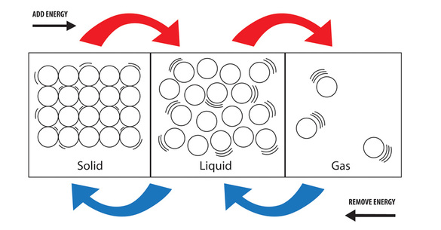
States of Matter
there are generally three states of matter, but here we focus on liquids
these have some properties like solids and gases:

Slide 3
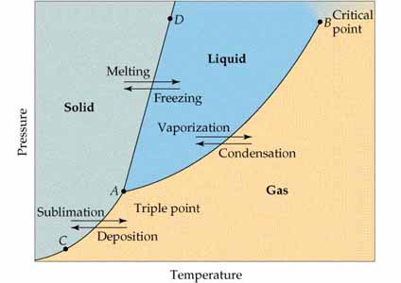
Changes of State
the following six terms describe the three phase change boundaries

Slide 4
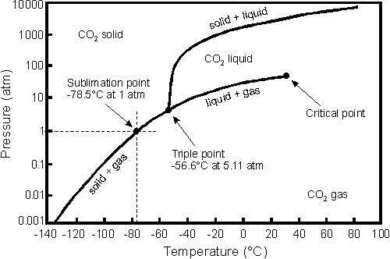
Carbon Dioxide phase diagram
Find the state of matter for CO₂; mark on the phase diagram.
A) 0.5atm, 0.0°C
B) 100.atm,-20°C
C) -100°C, 0.1atm
D) 80°C, 50atm

Slide 5
Phase Changes
These may occur by one phase gaining or losing enough energy to change states
the energy needed is known as the heat of fusion or heat of vaporization
the tabulated energy (per gram) is known as latent heat
It is worth noting water’s known quantities (1.00atm):
heat of fusion 334 J/g
heat of vaporization 2260 J/g
specific heat (liquid) 4.184 J/g-°C

Slide 6
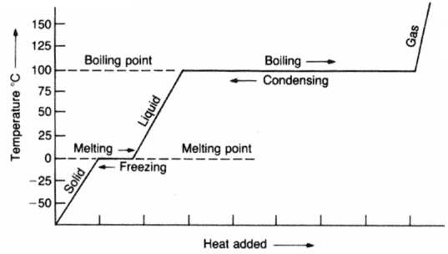
Cooling water
Calculate the energy required to change 75mL of water at 24°C to ice.
heat of fusion 334 J/g
heat of vaporization 2260 J/g
specific heat (liquid) 4.184 J/g-°C

Slide 7
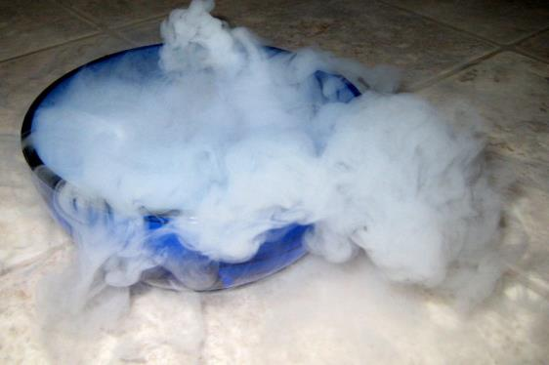
Vaporization
liquid particles at the surface may leave into the gas state
only occurs if enough kinetic energy available
since these particles escape with some energy, the surface is then cooler
vaporization can occur two ways from the liquid state: 1 Evaporation: random vaporization below boiling point 2 Boiling: forced vaporization at boiling point
vaporization can also occur from the solid to gas states
this is known as sublimation

Slide 8
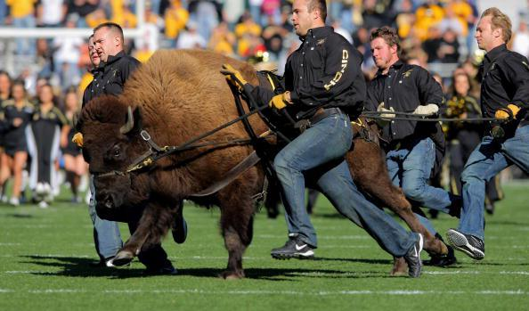
University of Colorado PhET

Slide 9
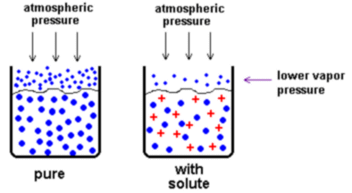
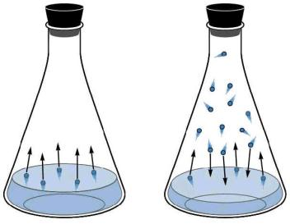
Properties of Liquids at the Surface
The pressure exerted by a gas on its liquid state is called the vapor pressure
this changes as a function of temperature
can also change by addition of solutes
if high, the liquid is said to be volatile

Slide 10
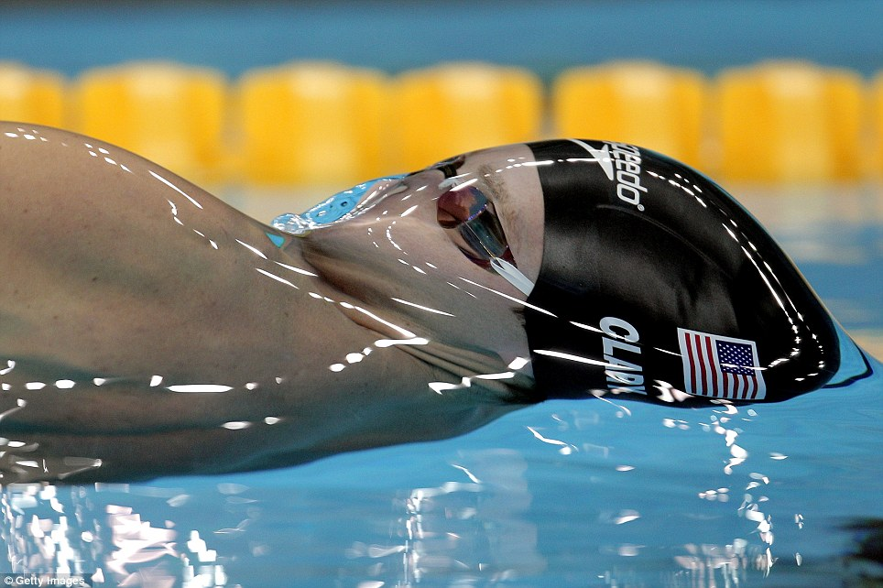
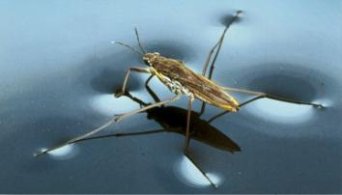
Surface Tension
Surface tension is resistance of a liquid to a change in surface area
this is due to intermolecular forces between liquid particles
if free, liquids will form spherical droplets

Slide 11
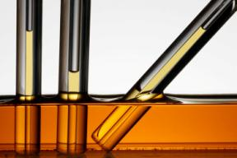
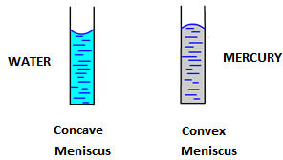
Surface Tension
In a column, a liquid may interact with the walls
Adhesive and cohesive forces balance to form one of two shapes of a meniscus
Adhesion > Cohesion
Cohesion > Adhesion
If adhesion dominates, a liquid may climb the walls of a narrow tube
known as capillary action

Slide 12
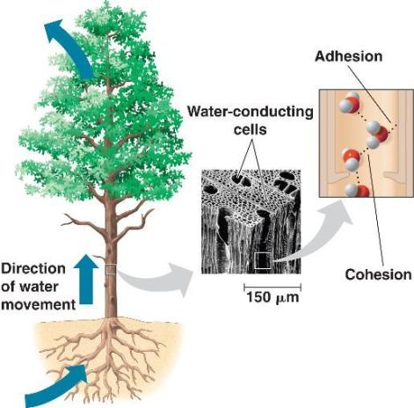
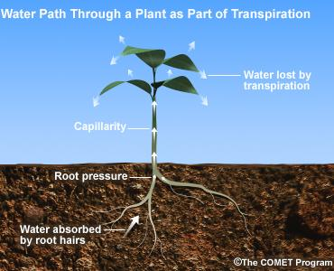
Capillary Action

Slide 13
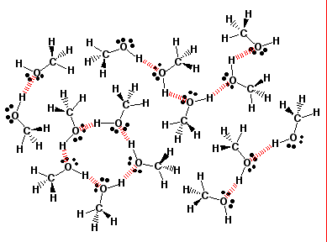
Water
many outstanding properties due to hydrogen bonds
these are weak interactions due to dipoles
usually occur between hydrogen and oxygen
Also N, F, Cl

Slide 14
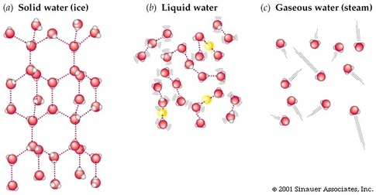
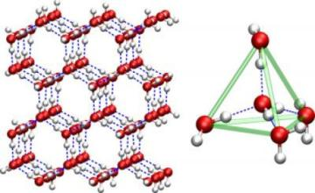
Water
A notable property is that hydrogen bonds help water freeze into a crystal lattice
this makes solid water less dense than liquid water

Slide 15
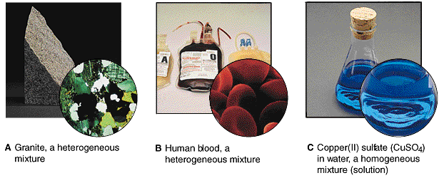
Review of Mixtures
two types: homogeneous and heterogeneous
most chemistry of solutions involves defining theory and limits of homogenous vs heterogeneous mixtures

Slide 16
SOLUTION:
there are always two parts (at least):
1. Solvent: majority component
2. Solute: minor, defining component
they can be separated by purely physical means
SOLUBILITY:
dependent on conditions like temperature and pressure
we say soluble, insoluble, or slightly soluble to describe this phenomena
ability to mix is described on a solubility chart
we can then describe a solution one of three ways
1. Unsaturated: below the solubility limit
2. Saturated: at the solubility limit
3. Supersaturated: beyond the solubility limit

Slide 17
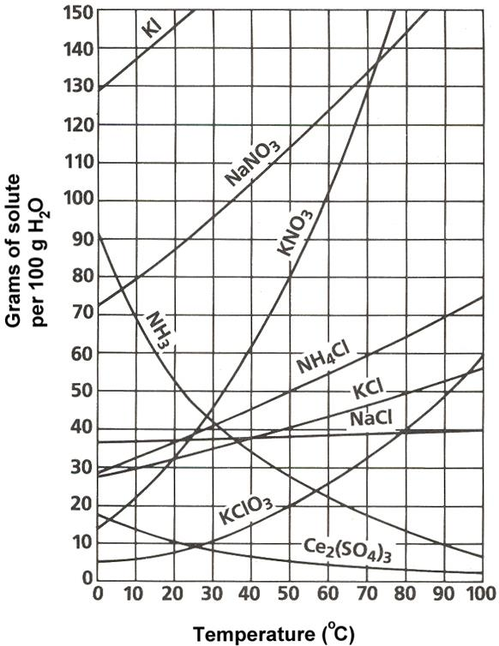
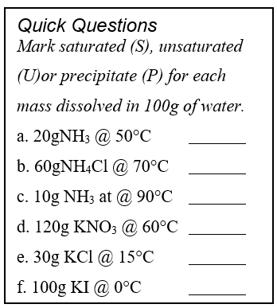
Solubility Chart

Slide 18
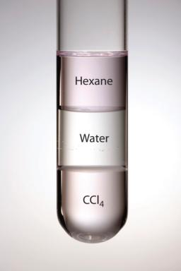
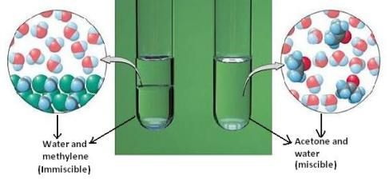
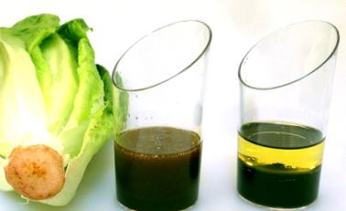
Miscibility
two liquids that can be combined in all proportions are said to be miscible
Otherwise immiscible
Mainly dependent on polarity: “like dissolves like”
POLARITY: separation of electric charge between atoms due to electronegativity difference

Slide 19
Polar Vs Nonpolar
Ex Are the following polar? Indicate the polarity.
H₂O CO₂
CH₂O NH₃
C₂H₅OH C₃H₈
CH₃Cl CH₄

Slide 20
CONCENTRATION
CONCENTRATION: measure of amount of solute in a solvent
there are many measures, in terms of numbers (moles), grams, or volume of parts
we can define many concentrations, including percent by mass or volume:
in chemistry, the most common form is MOLARITY
*Note: When mixing solids into liquids, we generally don’t consider solid volume since, once dissolved, it changes volume to become part of the liquid

Slide 21
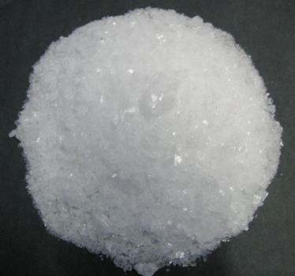
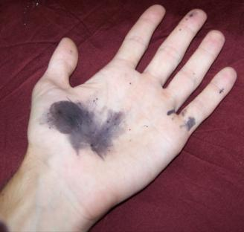
Silver Nitrate
We dissolve 91.25g of AgNO₃ in 500mL of water. What is the molarity of the solution?

Slide 22
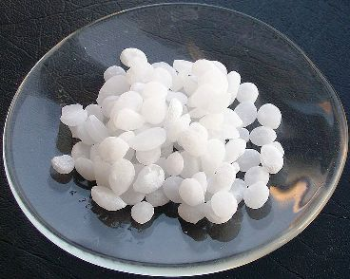
Potassium Hydroxide
We need to make 5.00L a 3.00M solution of KOH. How much KOH solid should we use?

Slide 23
Dilution
When working with liquid solutions, changing molarity involves a simple formula
Consider that changing the molarity always requires changing solution volume, but the number of moles of solute don’t change
for a dilution, we just add more volume of solvent
to increase concentration, you may boil away some solvent (to lower volume)
this is hardly ever done
the simple formula is:

Slide 24
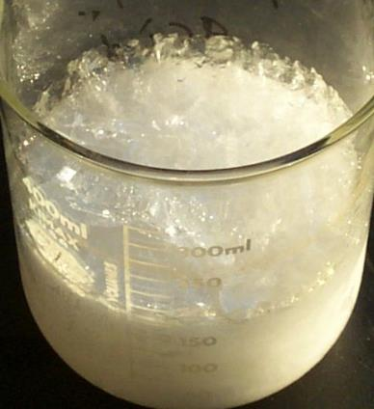
Diluting Vinegar
We would like to dilute full strength 17.5M acetic acid down to 0.01M, the strength of common vinegar. How much vinegar can be made with 250.mL of full-strength acetic acid?

Slide 25
Hydrochloric acid spill
250.mL of water is accidentally added to 1.00L of 6.0M HCl. What is the molarity after this slight lab mishap?

