Slide 1
Nuclear Chemistry
Chemistry

Slide 2
Topics in Nuclear Chem
Isotopes Review
Stability of Isotopes
Methods of Decay
Fission v Fusion
Power Plants
Weapons
By the end of the unit, we should be able to:
Write nuclear reactions
Identify a fission vs a fusion reaction
Conduct an informed debate the use of nuclear energy and weapons

Slide 3
Remember ISOTOPES?
Any unique atom (that is, isotope of an element) is called a nuclide
Protons and neutrons in a nucleus are called nucleons

Slide 4
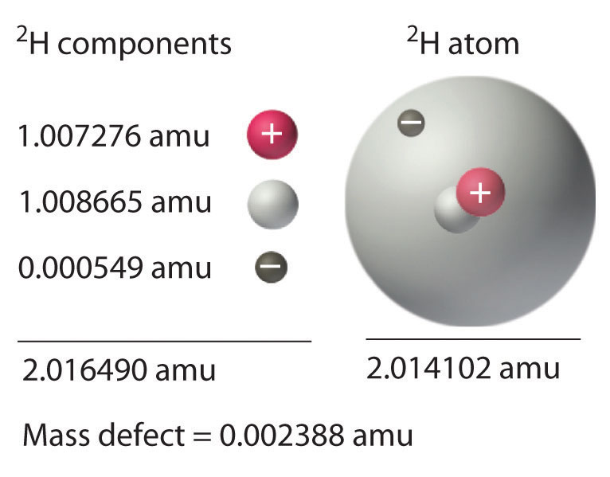
Thermodynamic Stability
Mass defect is the difference between the separated masses of nucleons and the actual nucleus mass
the amount of mass “missing” is the same energy holding nucleons together! ΔE = Δ mc²
Ex: Use the values in the figure shown to find the mass defect of one mole of ²H atoms.
Amu measurements are in grams but energy in Joules requires kilogram conversion

Slide 5
Kinetic Stability
_radioactive decay_:a special decomposition process by which the nucleus decomposes into several particles and/or energy
What are some considerations?
i. All nuclides with 84 or more protons are UNSTABLE
ii. Lighter nuclides are stable when the ratio of neutrons to protons is:
These fall in the valley of stability
There are some magic numbers of protons and/or neutrons that produce stable nuclei
2, 8, 20, 50, 82, 126

Slide 6
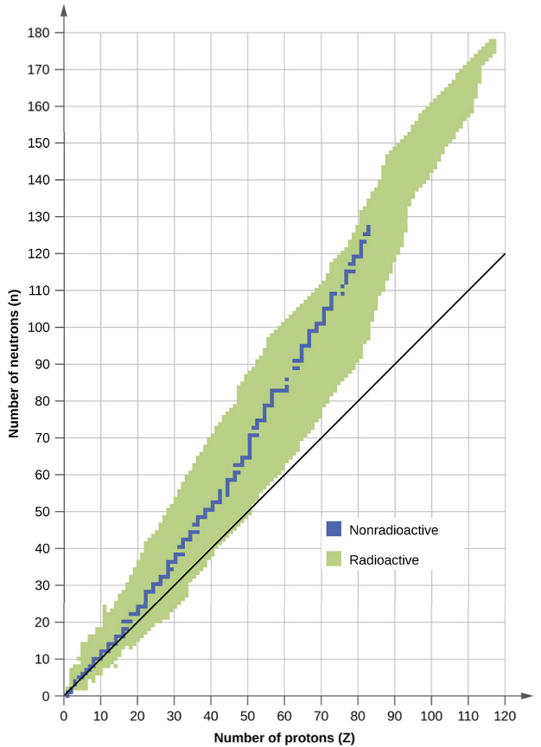

Slide 7
Nuclear Decay
α – particle production
for most heavy particles, they decay as an α – particle

Slide 8
Nuclear Decay
β – particle production
This occurs when a neutron becomes a proton
Results in the release of an electron
The electron accounts for the mass and charge difference

Slide 9
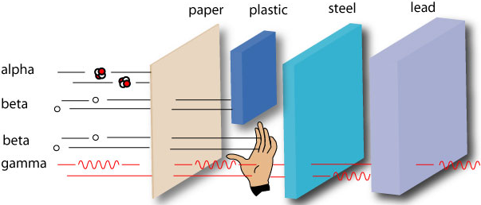
Nuclear Decay
γ – ray production
High energy photon that sometimes accompanies decays
Our previous equation is more properly written:

Slide 10
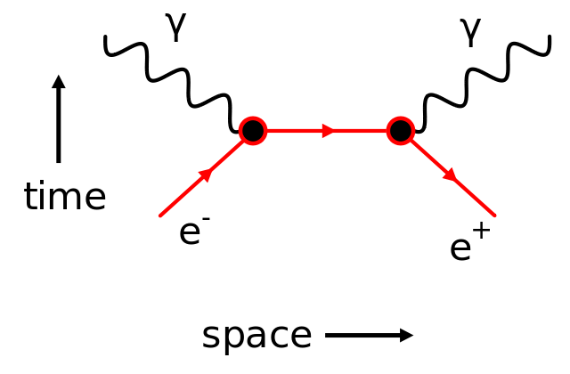
Nuclear Decay
Antimatter production
We may produce positrons, the antimatter to electrons
We may safely say this is a positively charged electron the antimatter to electrons
This occurs if we need to change a proton to a neutron
When a positron collides with an electron, annihiliation results!

Slide 11
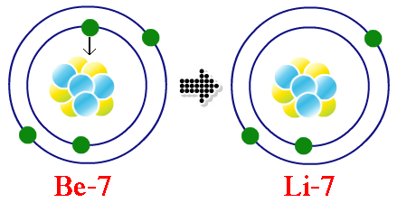
Nuclear Decay
Electron capture
If the nucleus takes an electron, there is a loss of a proton and production of light
This electron taken was from the INNER orbital (closest to the nucleus)
Ex: Write an electron capture for the conversion of beryllium to lithium.

Slide 12
Radioactive Decay
Half life is the time required for half of a sample to undergo nuclear decay
Ex: The half-life of Molybdenum-99 is 67 hours. How much of a 100mg sample is left after 335 hours? Sketch the first five half lives of this isotope.

Slide 13
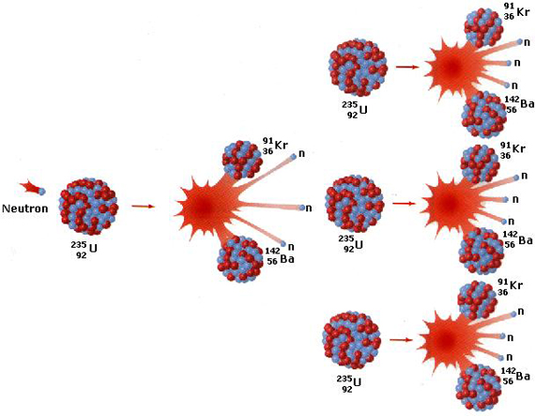
Nuclear Fission
splitting an atom into many particles by bombardment with neutrons
this allows additional fission reactions, called a chain reaction

Slide 14
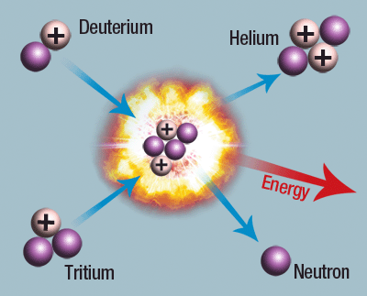
Nuclear Fusion
Combining two (or more) nuclei to form a new, stable nucleus
Since the new nucleus is more stable, energy is released
This is how stars produce energy, and new elements

Slide 15
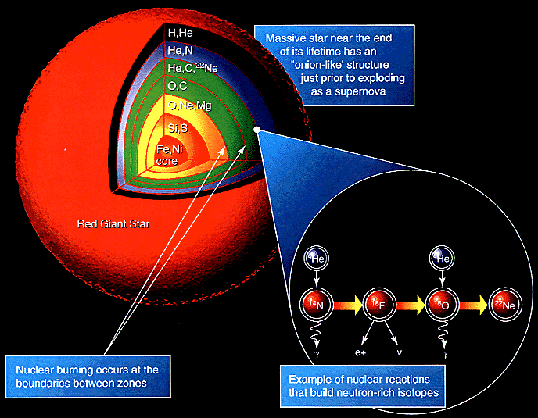

Slide 16
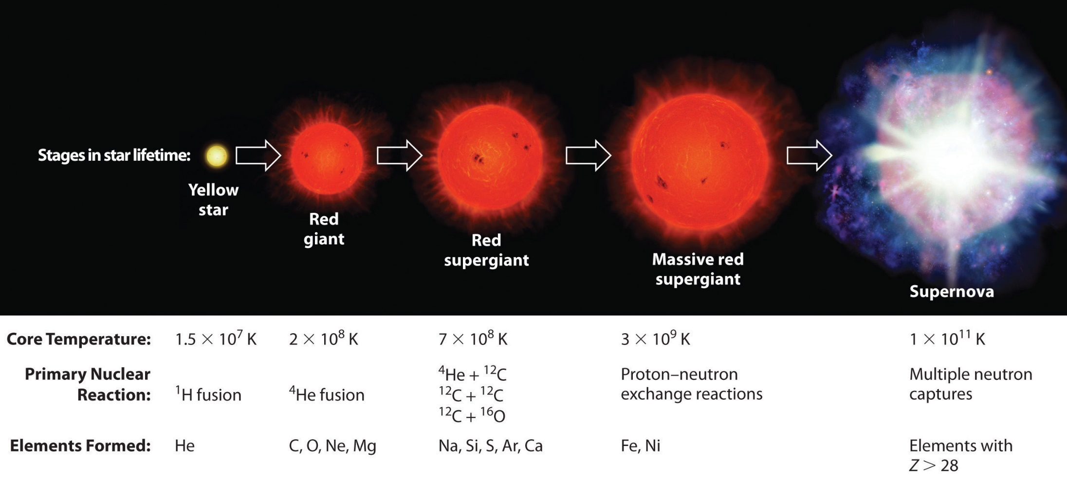
How stars produce elements

Slide 17
Nuclear Power
energy can be generated at a controlled rate using nuclear fission
fissionable material (about 3% ²³⁵U instead of the regular .7%) is allowed to react
this, in turn, vaporizes water which drives a steam turbine to produce electric current
a continuous water source is necessary to cool and recycle the process water
control rods can be moved in and out to absorb neutrons if necessary (to control fission)

Slide 18
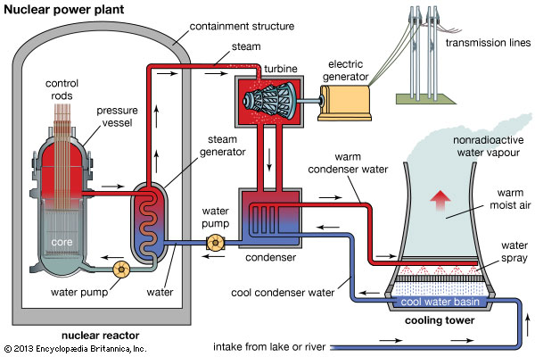
Nuclear Power Plant

Slide 20
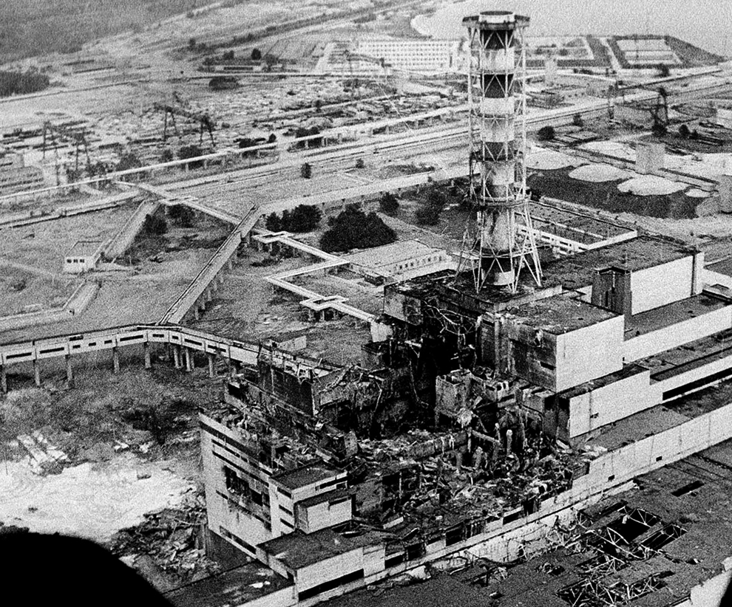
Chernobyl Meltdown
Chernobyl (Ukraine) April 26, 1986
Routine safety test with several simple (preventable) mistakes
Meltdown/Explosion due to control rods removed

Slide 21
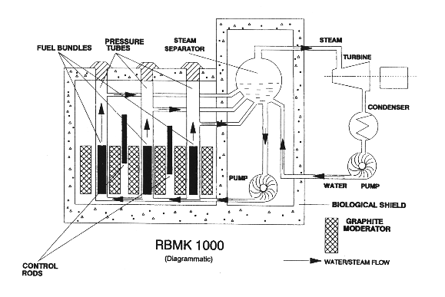
Chernobyl plant schematic

Slide 22
Chernobyl repairs, Oct 1986

Slide 23
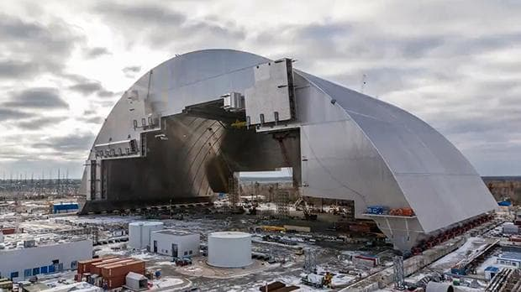
Chernobyl shell

Slide 24
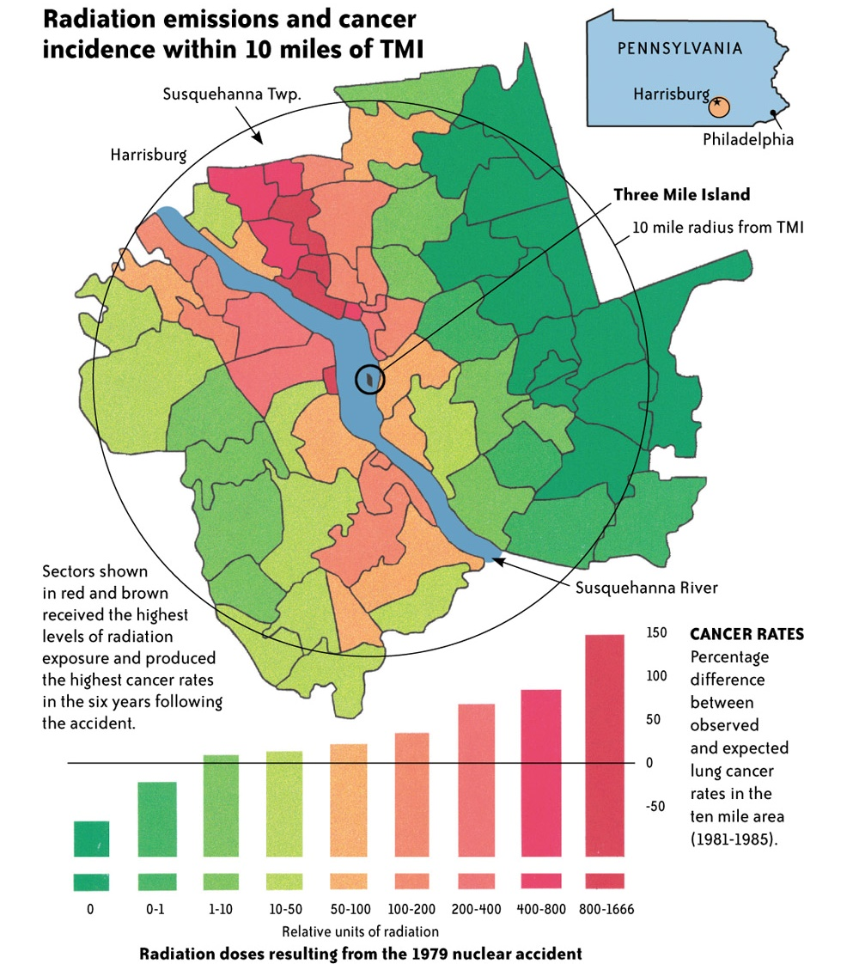
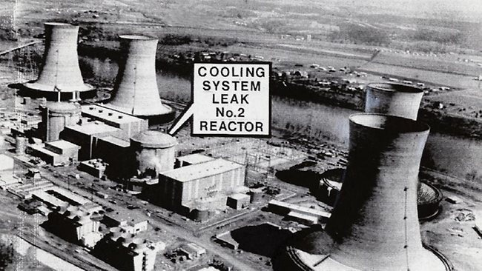
Three Mile Island “incident”
Three Mile Island (Pennsylvania, USA) March 28, 1979
Partial meltdown due to coolant inlet malfunction

Slide 25
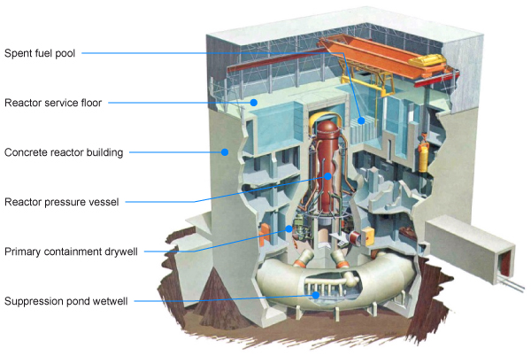
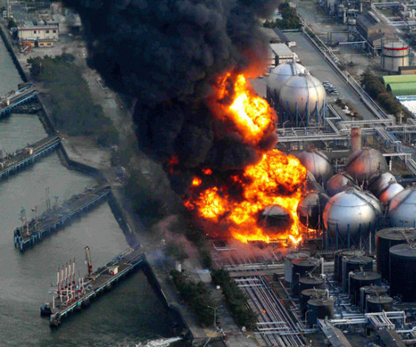
Fukushima Daiichi
Fukushima Daiichi (Japan) March 11, 2011
Earthquake causes tsunami; impact and flood cause leak of nuclear materials
Spent fuel (waste) also leaked into the ocean

Slide 27
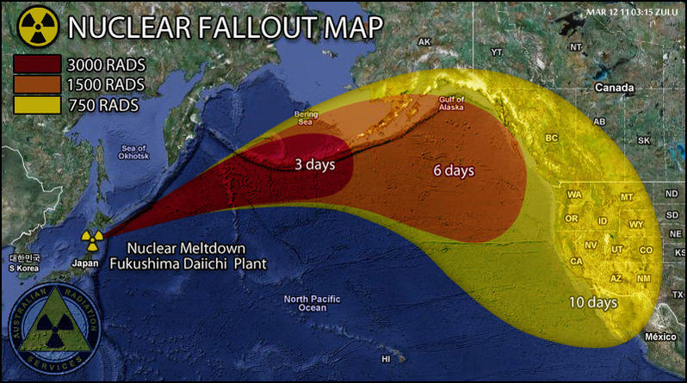
Fukushima Daiichi

Slide 29
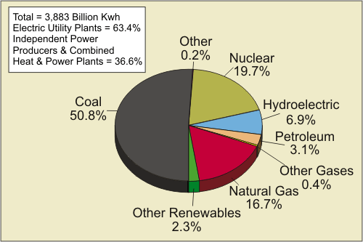
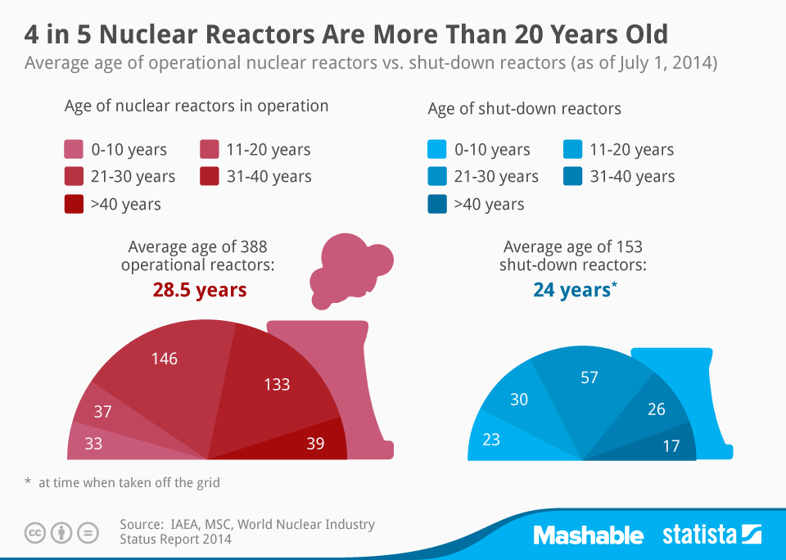
Nuclear Power
Benefits
Comparison of 1000MW power
1.0666 kg uranium
10,600 tons of coal
No CO₂ emissions

Slide 30
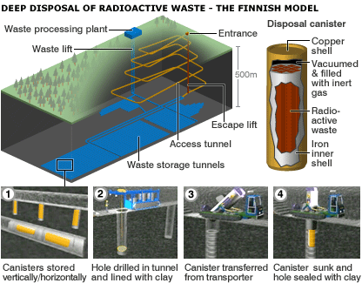
Nuclear Waste
Nuclear waste still not figured out
spent radioactive material packaged in “glass” and buried underground using robots
Proposed Yucca Mountain site not approved

Slide 31
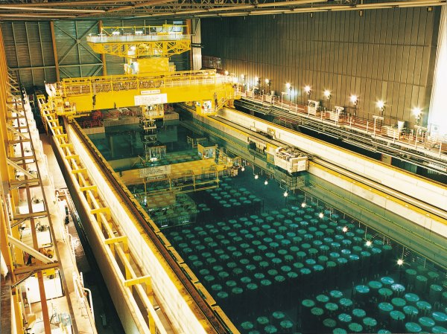
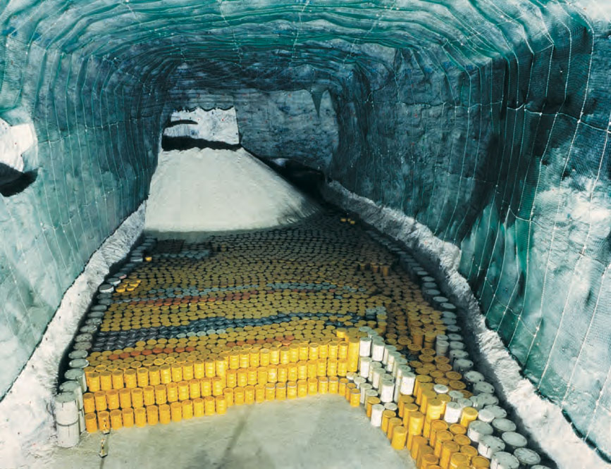
Radioactive waste

Slide 32
Nuclear Power
Pros | Cons

Slide 33
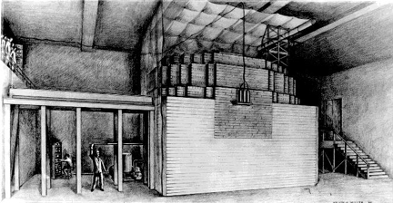
Nuclear Weapons
these were originally developed during WWII based on the research of the Italian scientist Enrico Fermi at Columbia and U. of Chicago
original idea came from German scientists, which led to the assumption that Germany was developing a weapon
Einstein’s letter to FDR was the key event in the beginning of the Manhattan Project in NM

Slide 34
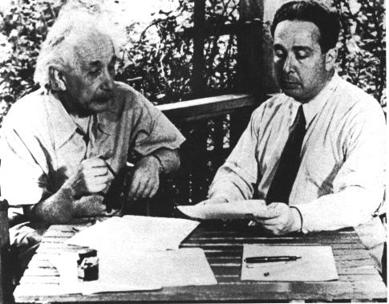
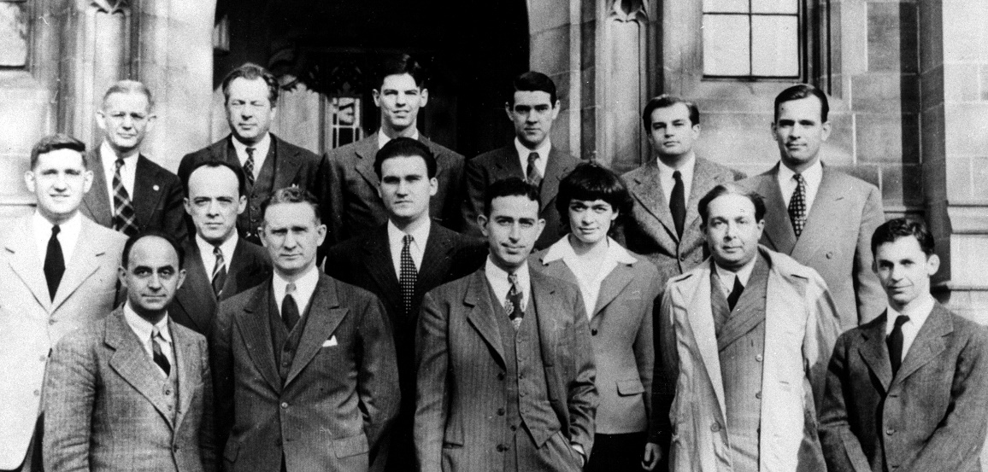
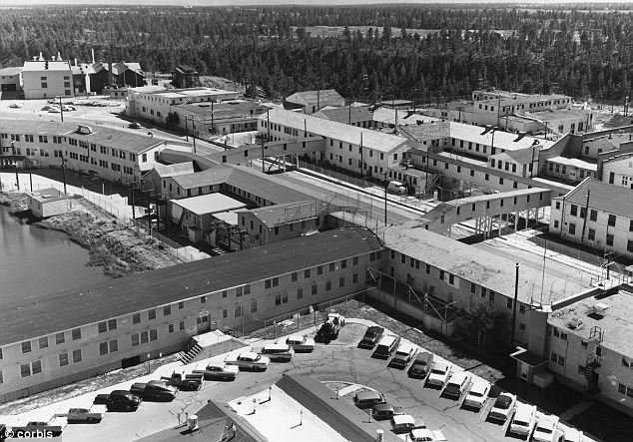
Manhattan Project

Slide 35
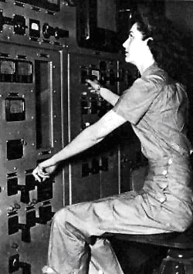
Manhattan Project

Slide 36
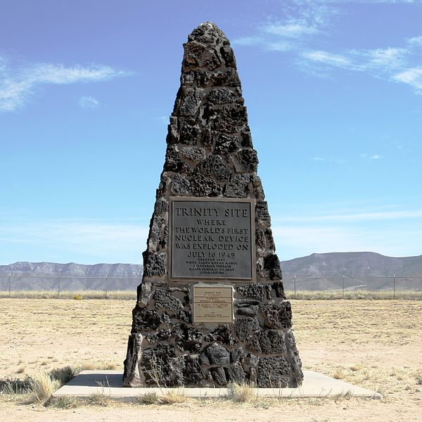
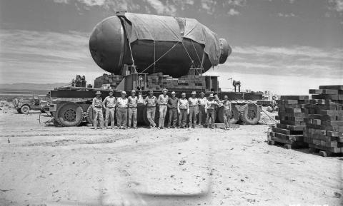
Trinity Site Test

Slide 37
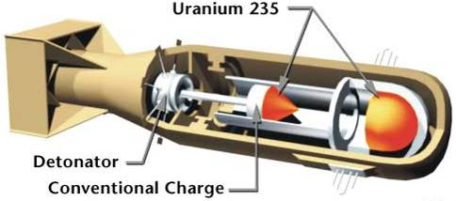
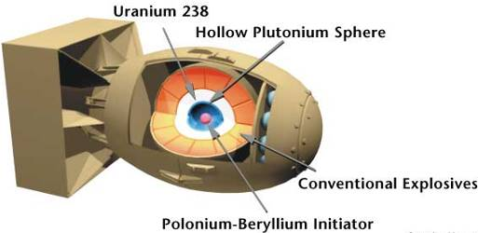
Nuclear Bombs WWII
the two nuclear weapons ever used were:
Hiroshima – Little Boy
Nagasaki – Fat Man
the alternative was an invasion of Japan
these weapons effectively ended the war by causing a surrender

Slide 38
Nuclear Weapons
Was it worth the suffering to use nuclear weapons to end World War II?
Was it just to use nuclear weapons to end World War II? Can you rationalize their use?
The USA leads the charge on nuclear non-proliferation. Is this country in the best position to lead this international effort considering:
USA is the only country to use nuclear weapons during a war
USA continues to hold a nuclear arms stockpile

Slide 39
Carbon-14 Dating
Method of finding the approximate date of an object based on remaining ¹⁴C
There is VERY little carbon-14 in any given sample of carbon
most is ¹²C
We compare amounts of carbon-14 and assume a proportion that was probably there initially (a long long time ago)
Note: half-life of carbon-14 is 5700 years
So, if you have 10g today, in 5700 years only 5g would remain
Mostly reliable, but may have errors up to 3000 years

Slide 40
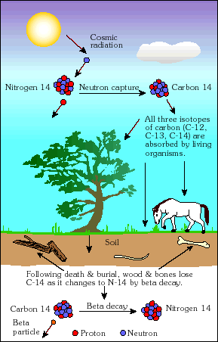
Carbon-14 cycle

Slide 41
Radioactive medicine
Radiotracers: allow doctors to follow a radioactive food/drug through the body
Allows careful monitoring
Positron emission tomography (PET)
Labelled molecules are checked for how they are metabolized
Abnormalities may be sensed
Radiation therapy
large radiation doses destroy tumors (side effects almost certain)

Slide 42
Irradiated food

