Slide 1
Properties of Matter
Chemistry

Slide 2
Compounds Worksheet
Count the number of atoms of each element in the given compound
a) K₃PO₄
b) Al₂(SO₄)₃
c) 7 units of (NH₄)₂CO₃

Slide 3
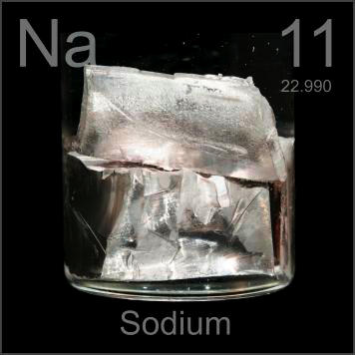
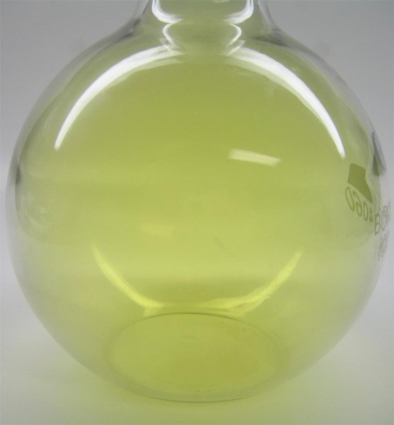
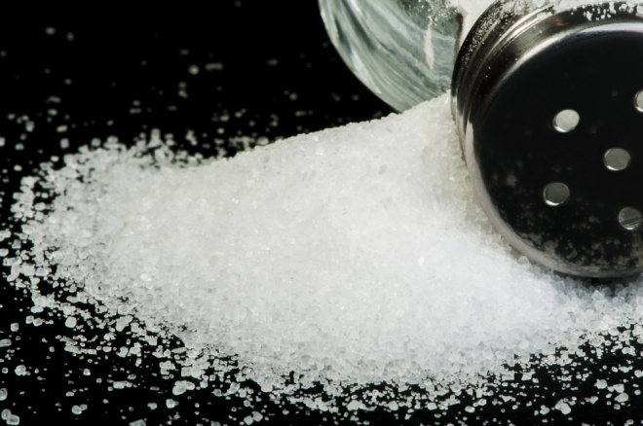
Matter
Matter is composed of atoms
Pure substances may be:
Elemental
Compounds

Slide 4
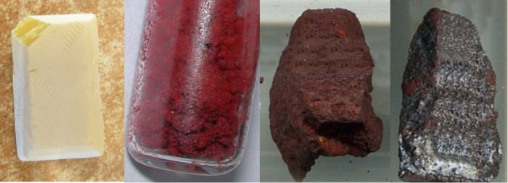
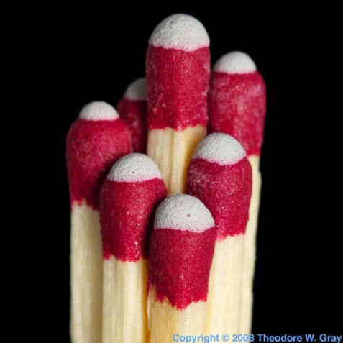
Elements
Simplest pure substances
Some elemental substances are made of multiple atoms
“diatomic” molecules: H₂, N₂, O₂, F₂, Cl₂, Br₂, I₂
allotropes

Slide 5
Compounds
Made of several elements in specific proportions
Systematic naming tells you what types of atoms are in a compound, and in some cases the proportions
Examples
Carbon dioxide
Dinitrogen monoxide
Carbon tetrachloride
Not always the case!
Sodium chloride
Magnesium chloride
We will learn the rules as the class goes on

Slide 6
Common chemical
Common chemicals have both a common name and a systematic name
In many cases, the common name is accepted
Examples
Water
Ammonia

Slide 7
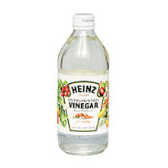
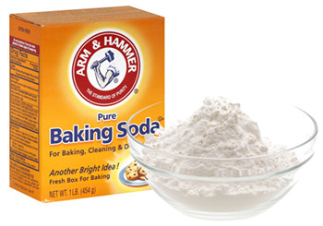
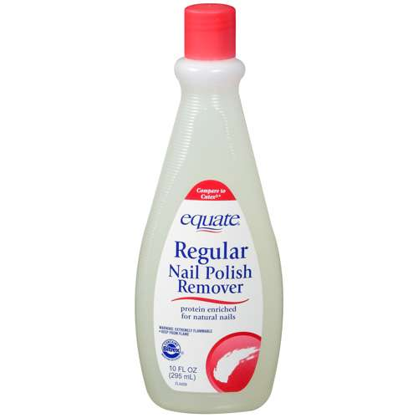
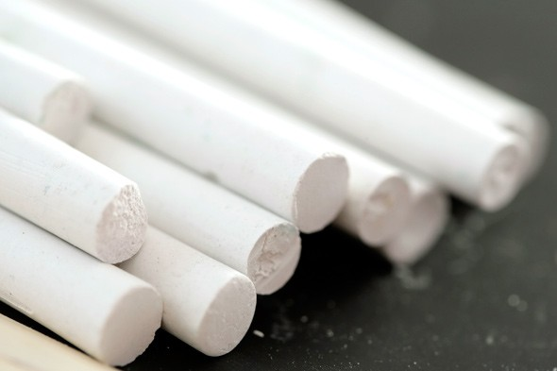
Common Chemicals review

Slide 8
Elements and compounds
Ex. Are the following elements, compounds, or both? Write the make-up of each.
a) S­₈
b) H₂CO₃
c) CH₃COOH
d) Mg(OH)₂
e) Ca₃(C₆H₅O₇)₂

Slide 9
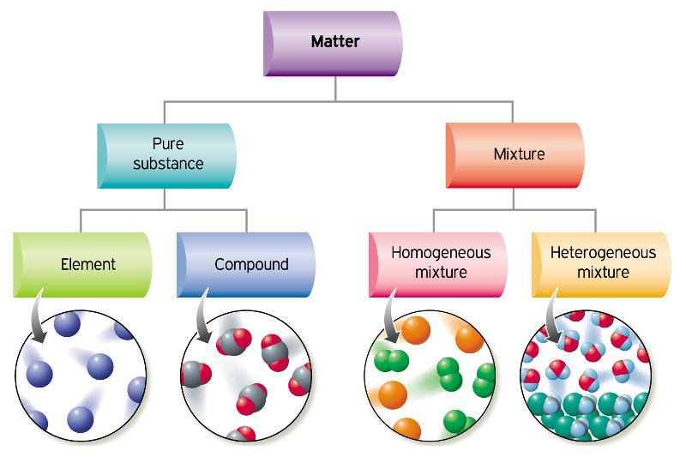
Classification of Matter

Slide 10
Classification of Matter by Composition
One type of particle
all samples show the same intensive properties
Multiple types of particles
samples may show different intensive properties

Slide 11
Classification of Pure Substances
made of one type of atom
combine together to make compounds
made of one type of molecule, or array of ions
molecules contain 2 or more different kinds of atoms

Slide 12
What are the states of matter?
Please write down the following:
What are the states of matter?
Give an example of a pure substance from each state of matter. Do not use water!
Give an example of something for which you are unsure of its state of matter.

Slide 13
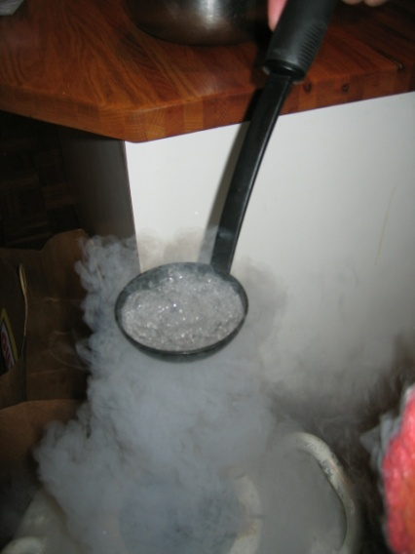
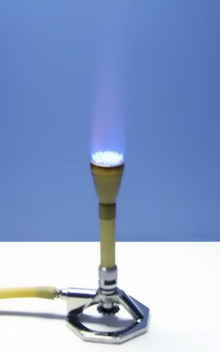
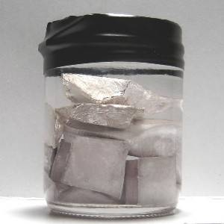
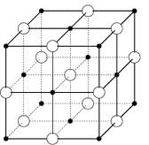
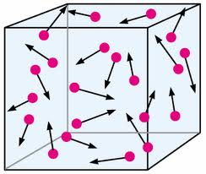
The Three Main States
Solid
Liquid
Gas

Slide 14
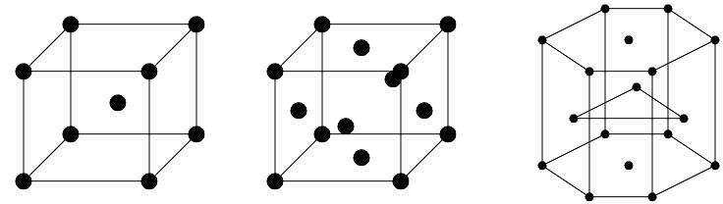
Solid Properties
Tightly packed particles
High density
Rigid
Definite shape and volume

Slide 15
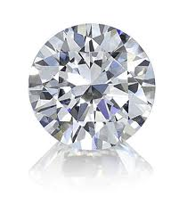
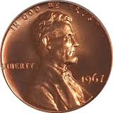
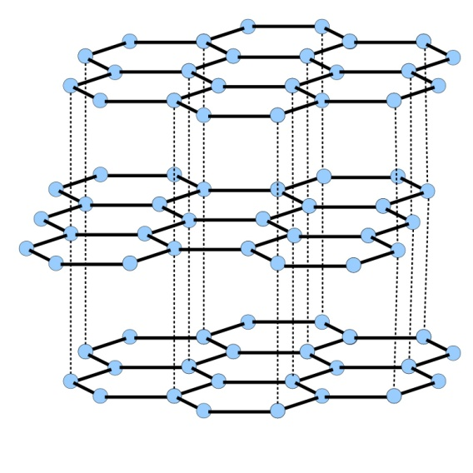
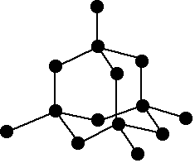
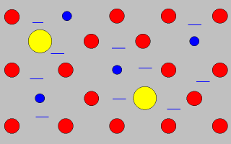
Examples of solids
metal alloy
graphite
diamond

Slide 16
Liquid Properties
Particles in motion
High density
Definite volume
Indefinite shape

Slide 17
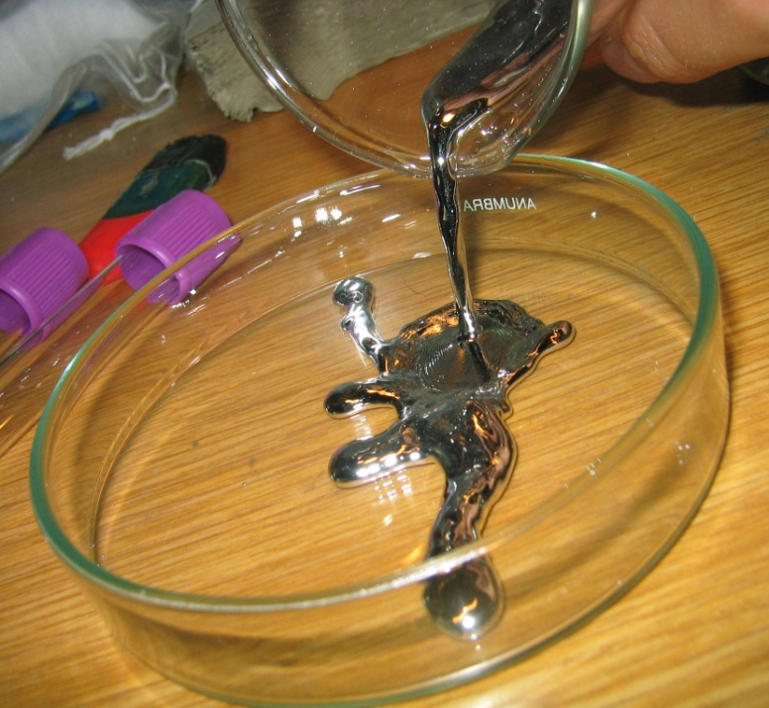
Examples of liquids
Methane on
Saturn’s moon Titan
Mercury

Slide 18
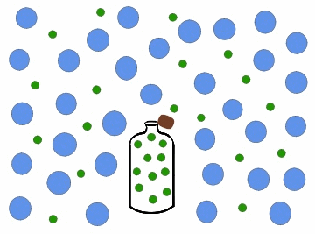
Gas Properties
Particles in motion
Very low density
Indefinite shape and volume

Slide 19
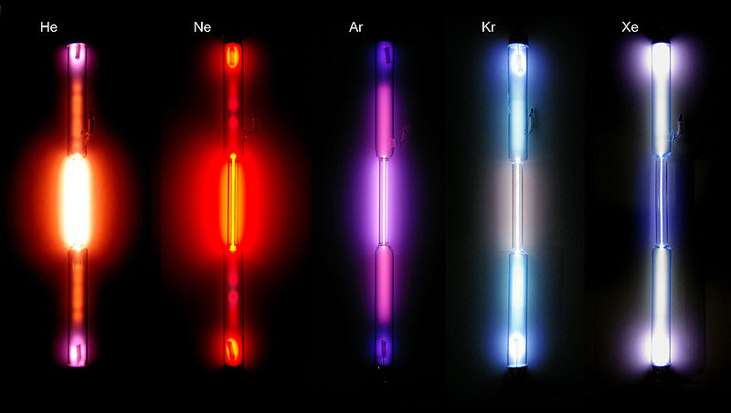
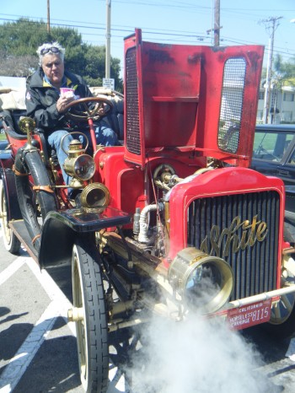
Examples of gases
Noble Gases
Steam

Slide 20
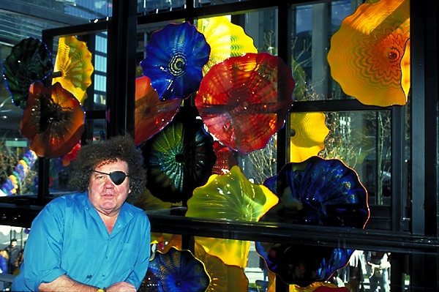
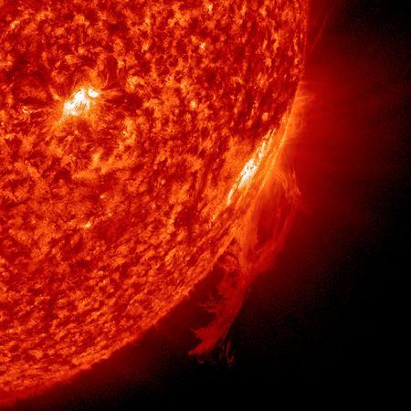
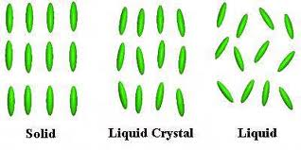
Other States of Matter
Plasmas
Glasses
Liquid Crystals

Slide 21
Classifying Matter by Physical State
Fixed = keeps shape when placed in a container
Indefinite = takes the shape of the container

Slide 22
Properties of Matter
physical properties are the characteristics of matter that can be changed without changing its composition
characteristics that are directly observable
chemical properties are the characteristics that determine how the composition of matter changes as a result of contact with other matter or the influence of energy
characteristics that describe the behavior of matter

Slide 23
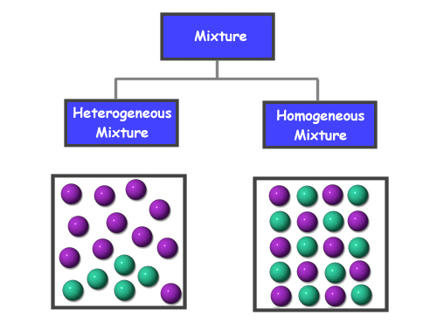
Mixtures

Slide 24
Classification of Mixtures
Homogeneous: mixture that has uniform composition throughout
every piece of a sample has identical characteristics, though another sample with the same components may have different characteristics
atoms or molecules mixed uniformly
Heterogeneous: mixture that does not have uniform composition throughout
contains regions within the sample with different characteristics
atoms or molecules not mixed uniformly

Slide 25
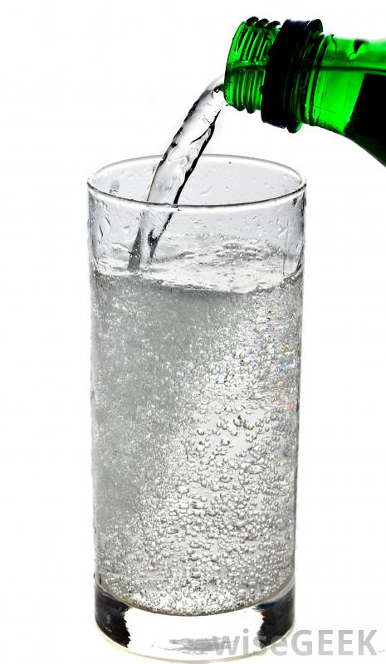
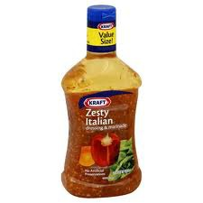
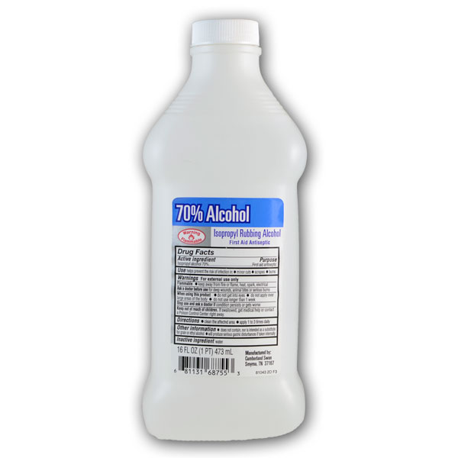
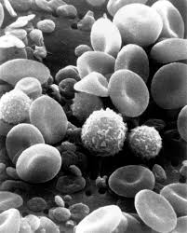
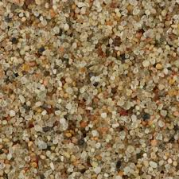
Classify

Slide 26
Separation of Mixtures
separate mixtures based on different physical properties of the components
Physical change
Different Physical Property
Technique
Boiling Point
Distillation
State of Matter (solid/liquid/gas)
Filtration
Adherence to a Surface
Chromatography
Volatility
Evaporation
Density
Centrifugation &
Decanting

Slide 27
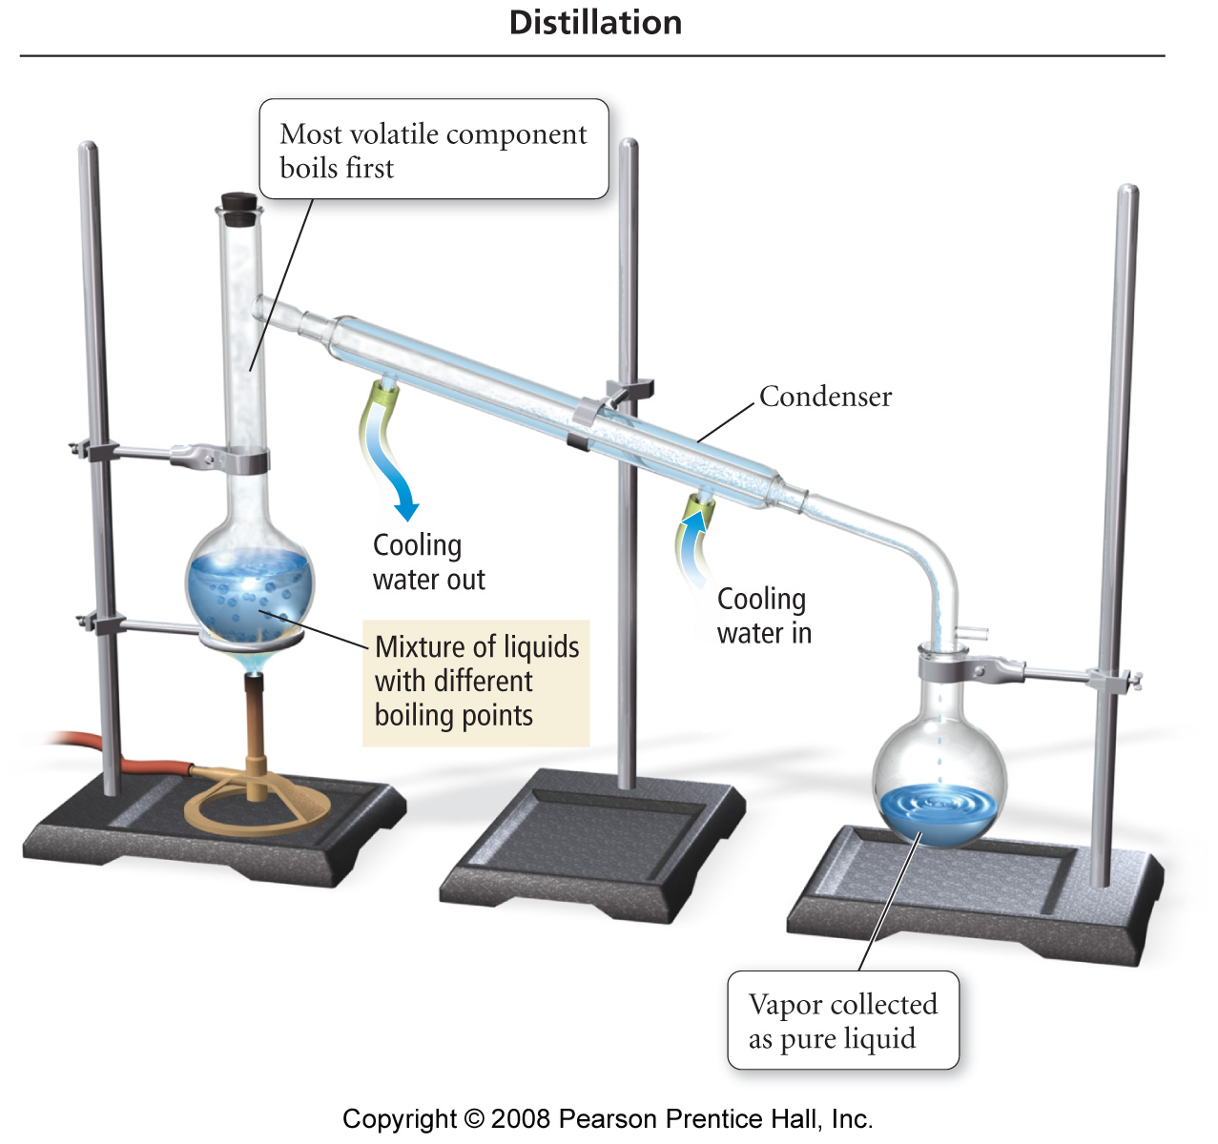
Distillation

Slide 28
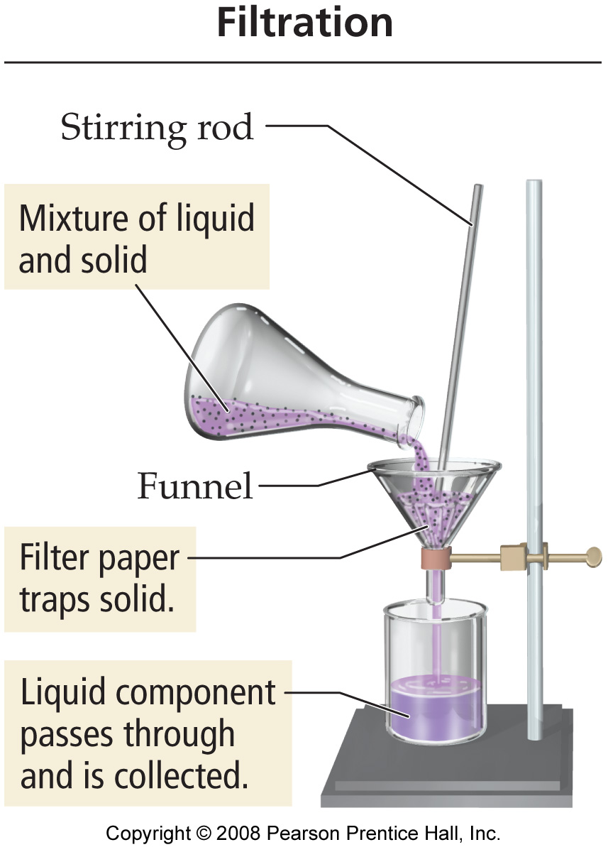
Filtration

Slide 29
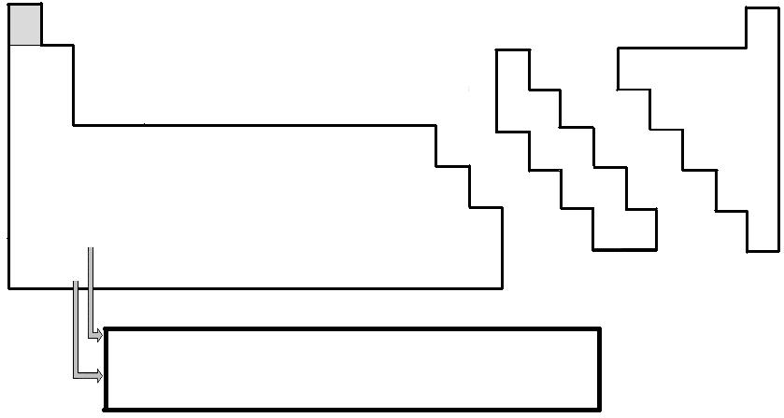
Periodic Table

Slide 30
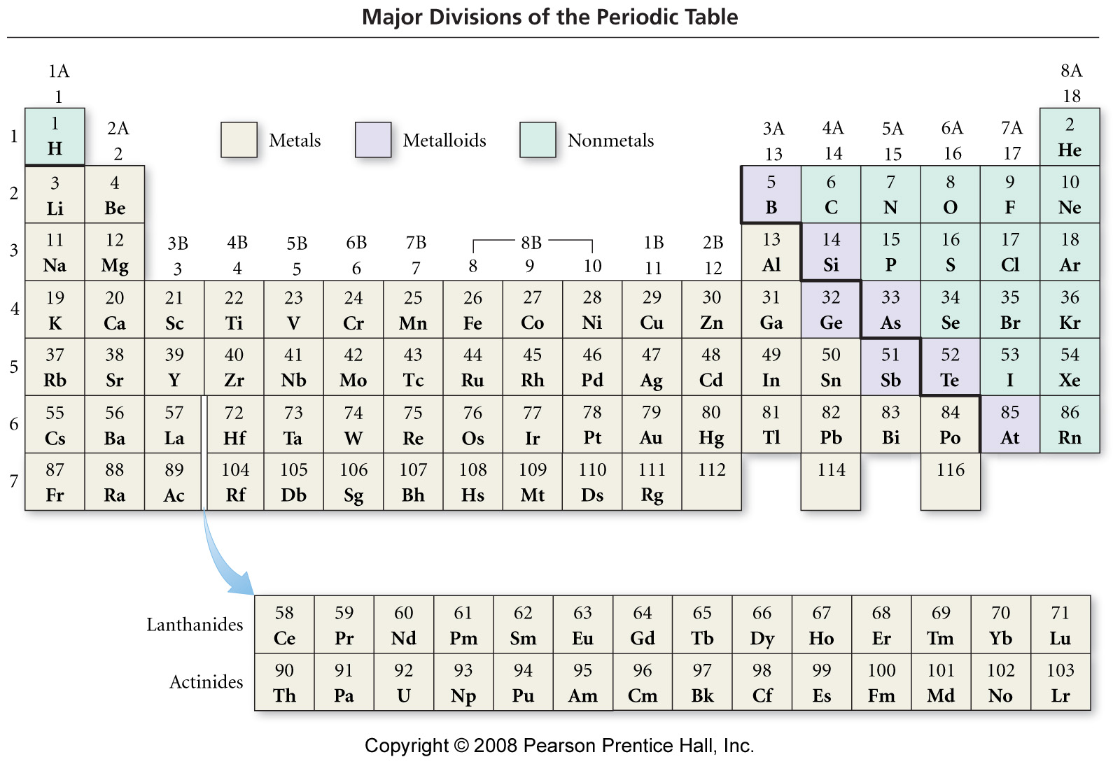
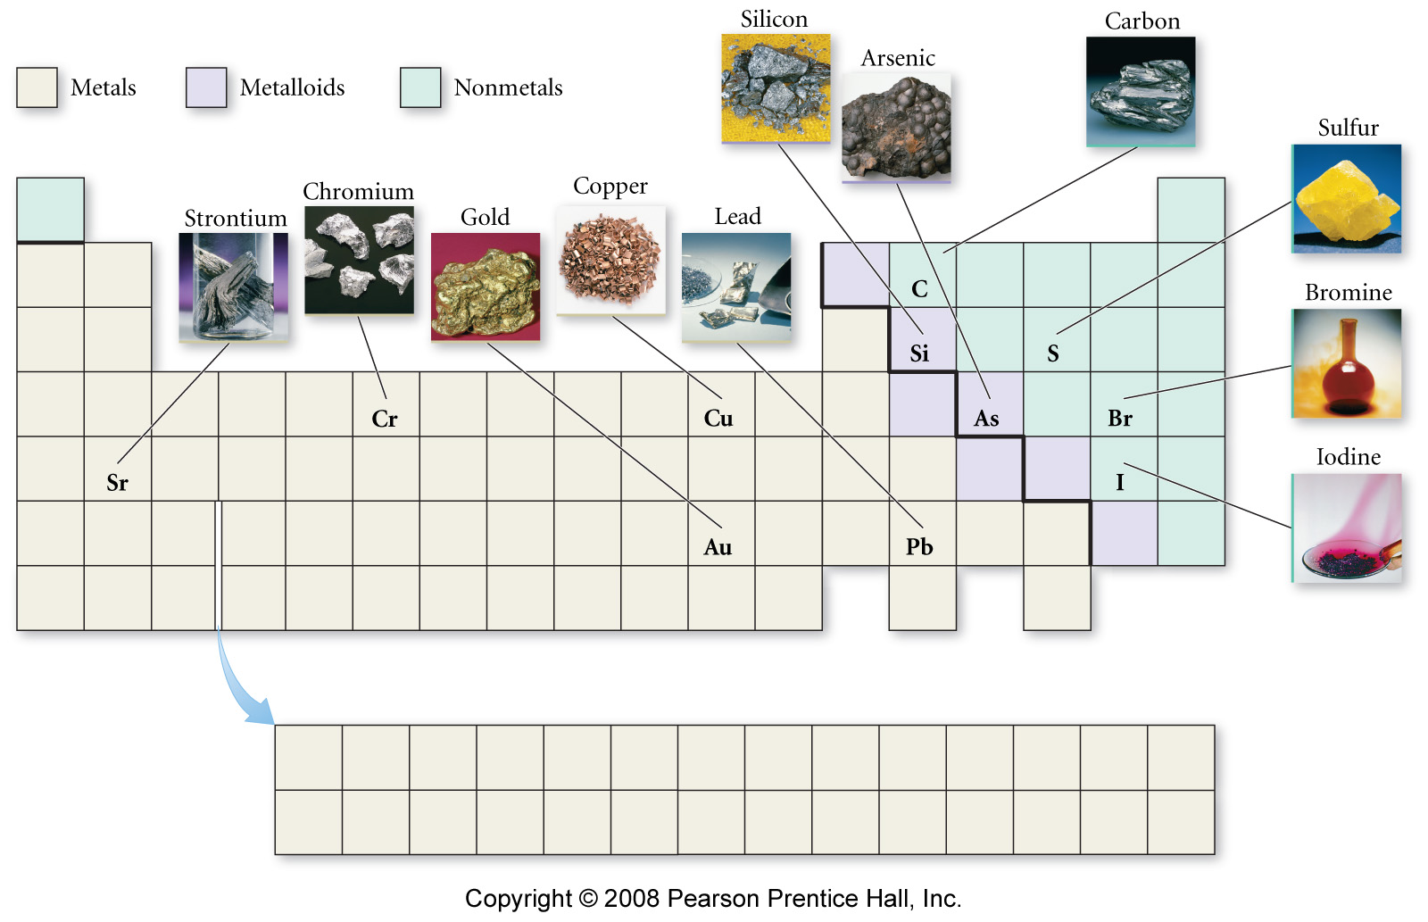

Slide 31
Metals
solids at room temperature (except Hg)
Lustrous: shiny reflective surface
Malleable: can be shaped
Ductile: drawn or pulled into wires
Conductors of heat and electricity
lose electrons and form cations in reactions
about 75% of the elements are metals
lower left on the table

Slide 32
Nonmetals
Sulfur, S(s)
found in all 3 states
poor conductors of heat
poor conductors of electricity
solids are brittle
gain electrons in reactions to become anions
upper right on the table
except H
Bromine, Br₂(l)
Chlorine, Cl₂(l)

Slide 33
Metalloids
show some properties of metals and some of nonmetals
also known as semiconductors
Properties of Silicon
shiny
conducts electricity
does not conduct heat well
brittle

Slide 34
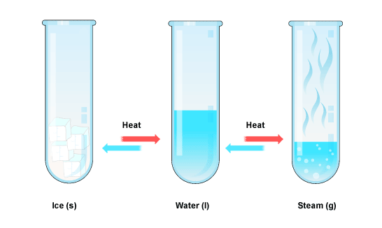
Changes in Matter
Physical changes: changes that alter the state or appearance of the matter without altering the composition
Chemical changes: changes that alter the composition of the matter are called during the chemical change,
the atoms that are present rearrange into new molecules, but all of the original atoms are still present

Slide 35
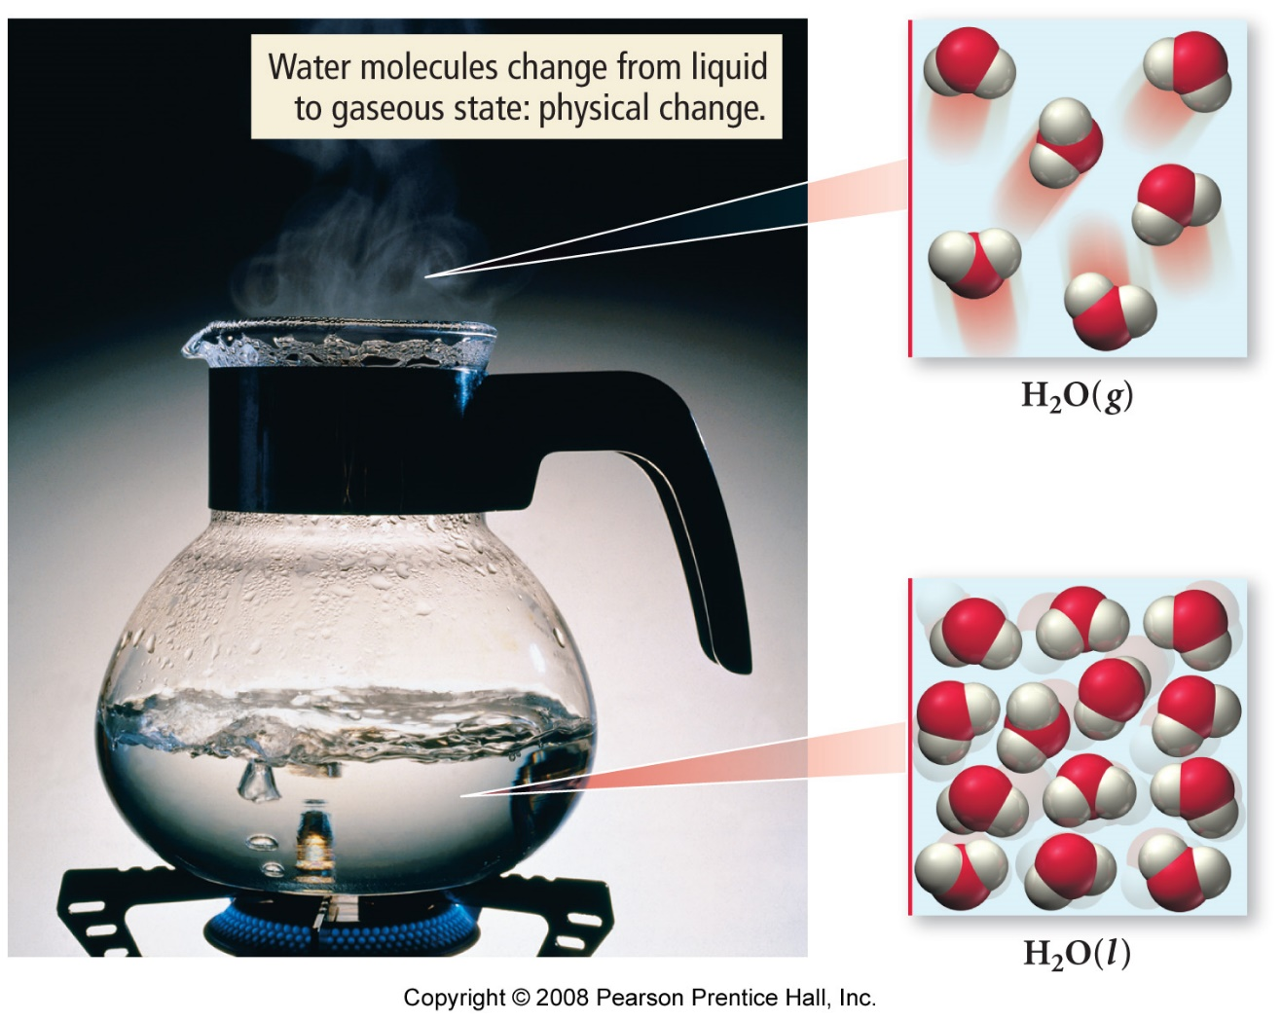
Physical Changes in Matter
Example:
Boiling of Water
Chemical composition is still H₂O, but in different physical states

Slide 36
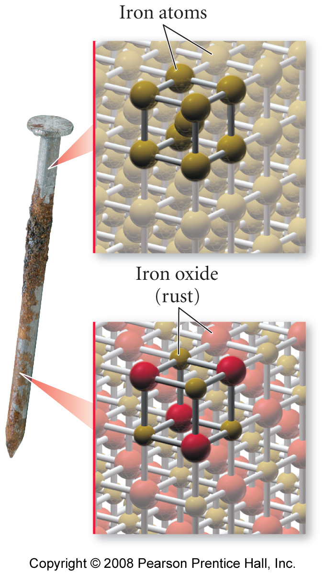
Chemical Changes in Matter
Example:
Rusting of Iron
The rusting of iron is a chemical change. The iron atoms in the nail combine with oxygen atoms from O₂ in the air to make a new substance, rust, with a different composition.

Slide 37
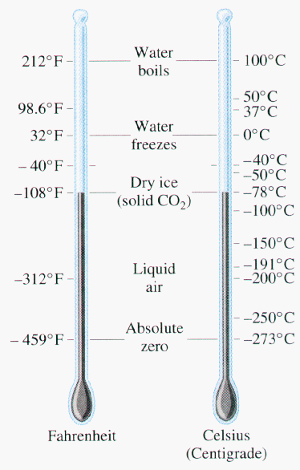
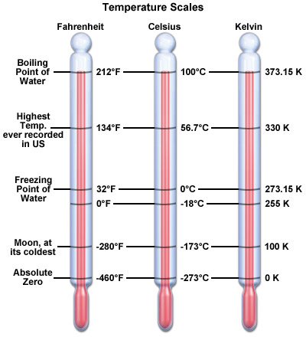
Temperature

Slide 38
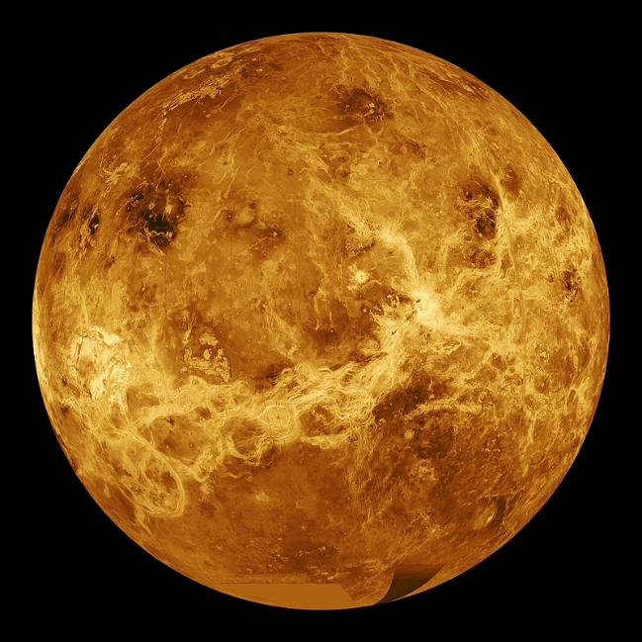
Converting temperature scales
Conversion formula:
We use the Kelvin in Chemistry:
Ex Find the Fahrenheit and Kelvin temperatures on Venus, which has a constant temperature 462C.

Slide 39
Heat
Heat: energy transferred between objects at different temperatures
Always transferred from high temp. object to low temp object
Specific heat: amount of heat required to raise one gram of material by 1°C
We can find the amount of energy transferred by the equation:
q = m c ΔT
Example: How much energy is needed to raise 250mL of water from 12°C (out of the faucet) to 95°C?

Slide 40
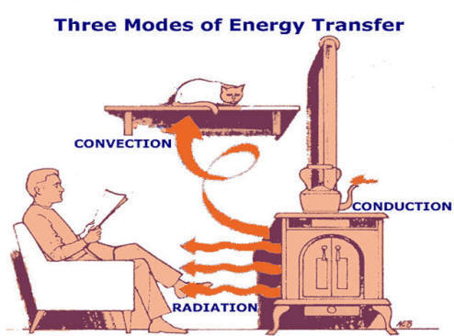
Heat and heat transfer
Three modes of heat transfer
Conduction: objects in contact transfer energy
Convection: bulk flow of a fluid transfers energy
Radiation: light acts as energy source

Slide 41
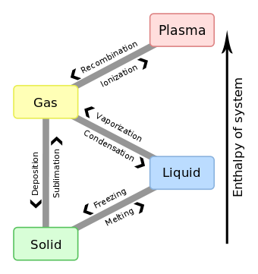
States of matter and Energy
Solid / Liquid
Liquid / Gas
Solid / Gas

Slide 42
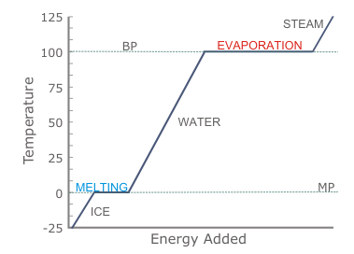
Energy and phase transitions
Latent heat:

