Slide 1
Scientific Measurements
Chemistry

Slide 2
Todo list
Chem Pre-Test
Intro to Matter
Units and Measures
SI System
Conversion factors

Slide 3
Socrative
Chemistry Pre-Test
Room #: SJBCHEMMC

Slide 4
SI Units
In USA, we commonly use the Imperial System for common measurements
this is difficult to use since every quantity is measured with different bases
Most countries, and purely scientific work, is done using the SI system
this stands for le Systeme Internacionale d’Unites
All quantities are based on the number 10
these are expressed using common prefixes

Slide 5
Units
Quantity | SI | Imperial | Other | measurement of …
Mass | kg | slug | eV | matter
Length | m | ft | ly | distance
Area | m² | ft² | acre | surface
Volume | m³ | ft³ | L, gal | space
Time | s |  | min, hr, year | events (successive)
Temperature | K | F | C | average atomic motion
Pressure | Pa | psi | atm, bar, mmHg,torr | force on area
Energy | J | BTU | cal | Capacity for work

Slide 6
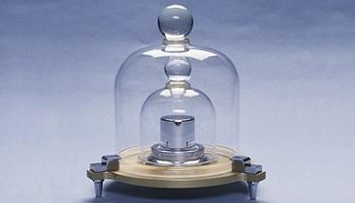
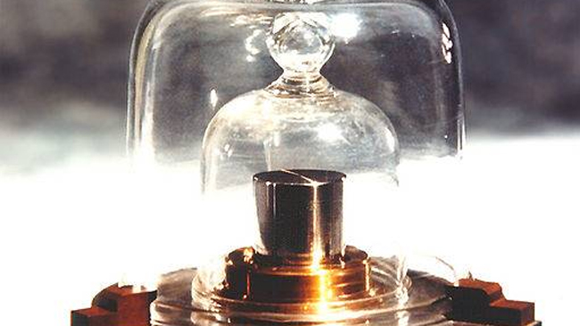
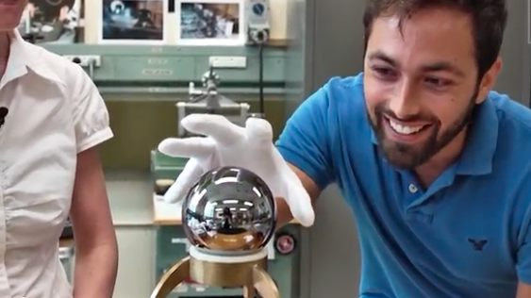
The Kilogram

Slide 8
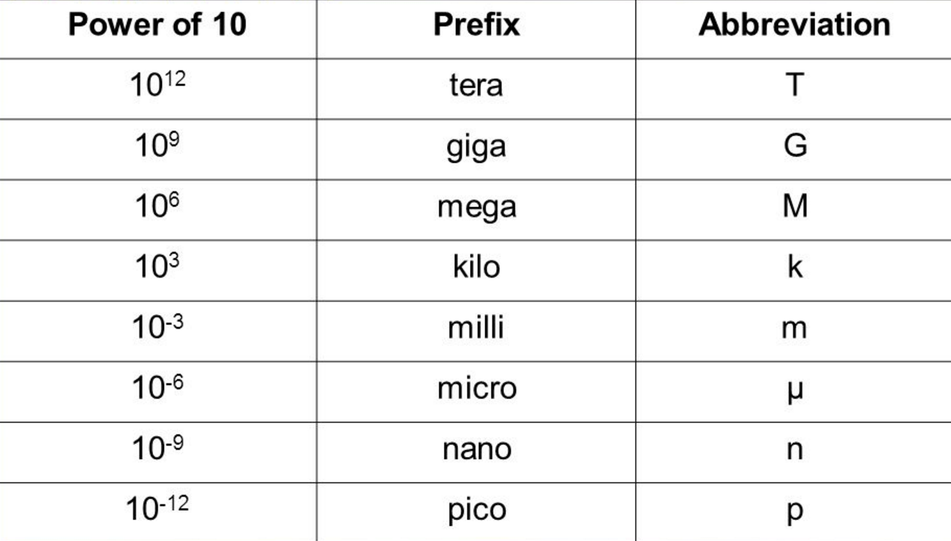
Prefixes
Most units require the use of very small or very large numbers, depending on the application
two methods are to use scientific notation of tens or standard prefixes
prefixes generally move in powers of 10³

Slide 9
Write the scientific notation.
a) 13 700 000 000
b) 0.000 006 71
c) 123 000

Slide 10
Write the following using scientific notation.
a) 14 Mton
b) 670 kPa
c) 945 mm

Slide 11
Write the following using scientific prefixes.
a) 190 000 000 s
b) 168 000 m
c) 0.049 12 m

Slide 12
Using scientific prefixes
We can treat these as unit conversions
Two ways to do this, but really the same
Ex Convert the size of 138nm long molecule to meters.
Ex How much space does a 2.5petabyte hard drive have, in terms of bytes?

Slide 13
Accuracy vs Precision
ACCURACY: measurements close to the true value
PRECISION: measurements that are reproduceable
precision is expressed in the number of significant figures
some “zeros” really only hold a place for the tens power
the exception is if a point is made to include the zero as significant
we write this as a zero with a period
we apply basic estimation rules around the number five

Slide 14
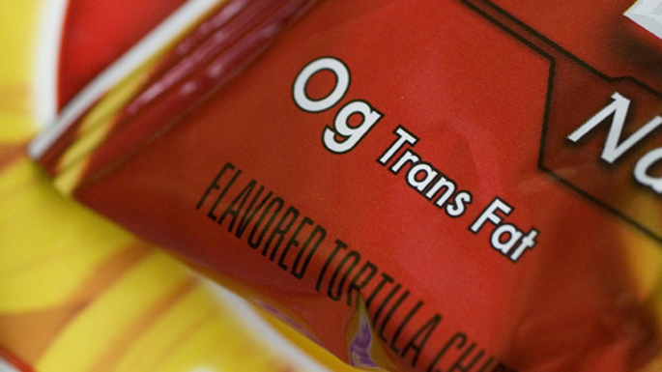
Chips
A potato chip producer claims their product has “no trans fat”, then writes 0g per serving. Does this mean there is no trans fat?

Slide 15
Sanitizer
A bottle of hand sanitizer says it kills 99.99% of germs. Can they say they kill (a) 100% of germs and (b) all germs?

Slide 16
Costs
A plumber says he will charge about $80 to replace a pipe. How much should you expect to pay?

Slide 17
Rules for Significant Figures
ZEROS
zeros count as sig figs if they’re
between numbers
at the end of a decimal
they don’t count if they’re
at the beginning of a decimal, since they’re just indicating the tens place
at the end of a large number, unless there’s a purposeful decimal
MULTIPLICATION/DIVISION
pick the number with the least amount of sig figs… that’s how many sig figs are in the answer
ADDITION/SUBTRACTION
pick the least precise number… that’s how precise your answer is

Slide 18
Calculate the following.
Use proper significant figures in your answer
a) 10.2 x 0.4457
b) 16.3 – 12.17
c) 100 / 7.5
d) 14.82 + 9.4119

Slide 19
Unit Conversions
these are used to go between different units using a ratio or conversion factor

Slide 20
Convert the following.
a) 8.25ft to m
b) 9 345 J to BTU

Slide 21
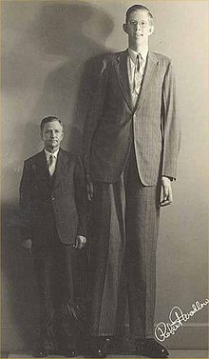
Tallest Man
Robert Wadlow was the tallest person in history. His hypertrophy of the pituitary gland provided an excessively high level of HGH. Shortly before he died at the age of 22, he measured 8’ 11’’ and weighed 439lb. Convert these measurements to the SI system. He is pictured to the right with his father, Harold, who stands 6’ 0’’.

Slide 22
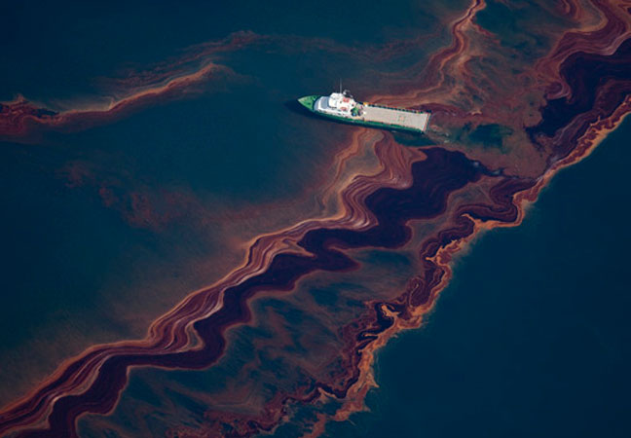
Oil Spill
An oil spill of 75 000gal forms a slick of 0.5nm height. Calculate the area in square meters that it covers.

Slide 23
Temperature
The temperature conversion is different since you must use any of the following formula:
Convert the following.
a) 79°F to C
b) 50.°C to °F
c) 210 K to °C

Slide 24
Unit Ratios
these provide information to relate two unrelated quantities
we can multiply and divide them; the numerator and denominator are interchangeable
Carl Lewis ran the 100.m dash in 9.92s. What was his speed in meters per second, feet per second, and miles per hour? Also, graph his speed in this race.

Slide 25
Gasoline
Gasoline costs $4.199 per gallon. You need gasoline for a school project, and decide to carry it in a 2.0L soda bottle. Calculate the cost of this gasoline.

Slide 26
Unit conversions
Make use of unit ratios
Ex A car tire must be inflated to 44psi; if a gauge reads 43.7psi, calculate the pressure in atmospheres.
Ex A bottle containing 2.75L hoods how much liquid, in terms of cubic feet

Slide 27
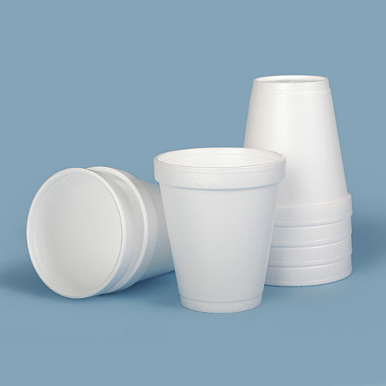
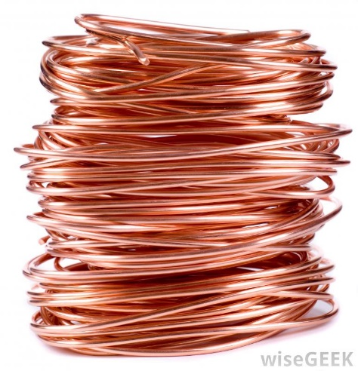
Density
Measures the mass per unit volume
Often refers to how “heavy” an object is
Ex Copper has a density of 8.96g/mL. Calculate the volume of 45.234g of copper.

Slide 28
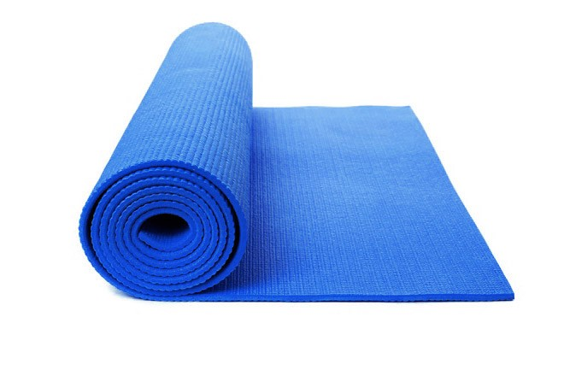
Foam mat
A foam workout mat has a mass of 1.8kg. It has dimensions of 3.0m x 0.75m x 5.4cm. Calculate the density.

