Slide 1
The Periodic Table
Chemistry

Slide 2
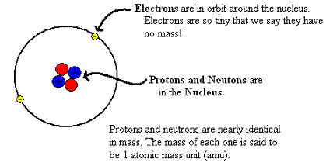
The Atom
The atom is made up from three subatomic particles:
Protons
Neutrons
Electrons

Slide 3
History of periodic table
TED video on history of periodic table
https://youtu.be/fPnwBITSmgU

Slide 4
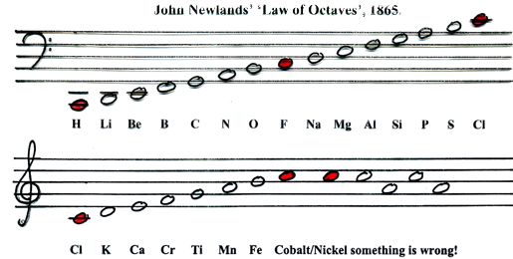
History of the Periodic Table
1865, John Newlands listed the elements and grouped them according to size and their physical/chemical properties
he noticed the properties recurred every eight elements approximately
considered a relationship to the musical octaves
he referred to this as the octave rule
this was the basis of the well-known octet rule

Slide 5
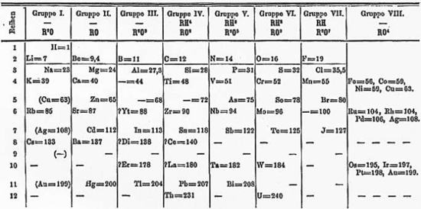
History of the Periodic Table
Dmitri Mendeleev produced a table of elements, but started over with new rows every time the chemical properties recurred
this repetition of the same pattern makes it periodic
in some cases, he couldn’t find a similar element, so he left blanks
notable example is Technecium which does not exist naturally and was not synthesized artificially until 1937

Slide 6
The Periodic Table
The periodic table represents all known elements
they are grouped in: families (columns) and groups (rows)
each element is given a unique symbol
most element names are just the first one or two letters, and tend to be intuitive
Ex Write the element symbols. a) C = b) Li = c) U =
Ex Write the element symbols. a) Nitrogen = b) Zinc = c) Helium = Nickel = Zirconium = Hydrogen =

Slide 7
Latin names
Others are taken from Latin names, and aren’t as intuitive
Ex Write the element name, and the original Latin name.
a) Na = b) Pb =
c) Iron = d) Tin =

Slide 8
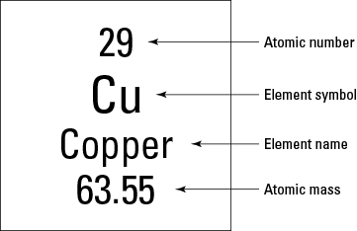
Periodic Table Information
The box on the table gives three important pieces of information:

Slide 9
Reading the periodic table
Ex Fill in the table.
Symbol Name Protons Atomic Mass
Po
Cr
W
Ra
H
In

Slide 10
Periods
These indicate a row of increasing electrons
Elements in a row do not have similar properties, but they increase in size (more electrons)
Within a period, each successive element has one more valence electron
these are the electrons involved in bonding
Ex Draw the Bohr model of each.
Na Be Al C N

Slide 11
Groups (Families)
These indicate a column of similar elements
Since electrons determine how atoms bond
All elements in the same family have the same bonding pattern
Ex. Give two elements with characteristics similar to the given element.
a)Ar b) Rb c) Al d) Si
Periodic element you tube
https://youtu.be/zUDDiWtFtEM

Slide 12
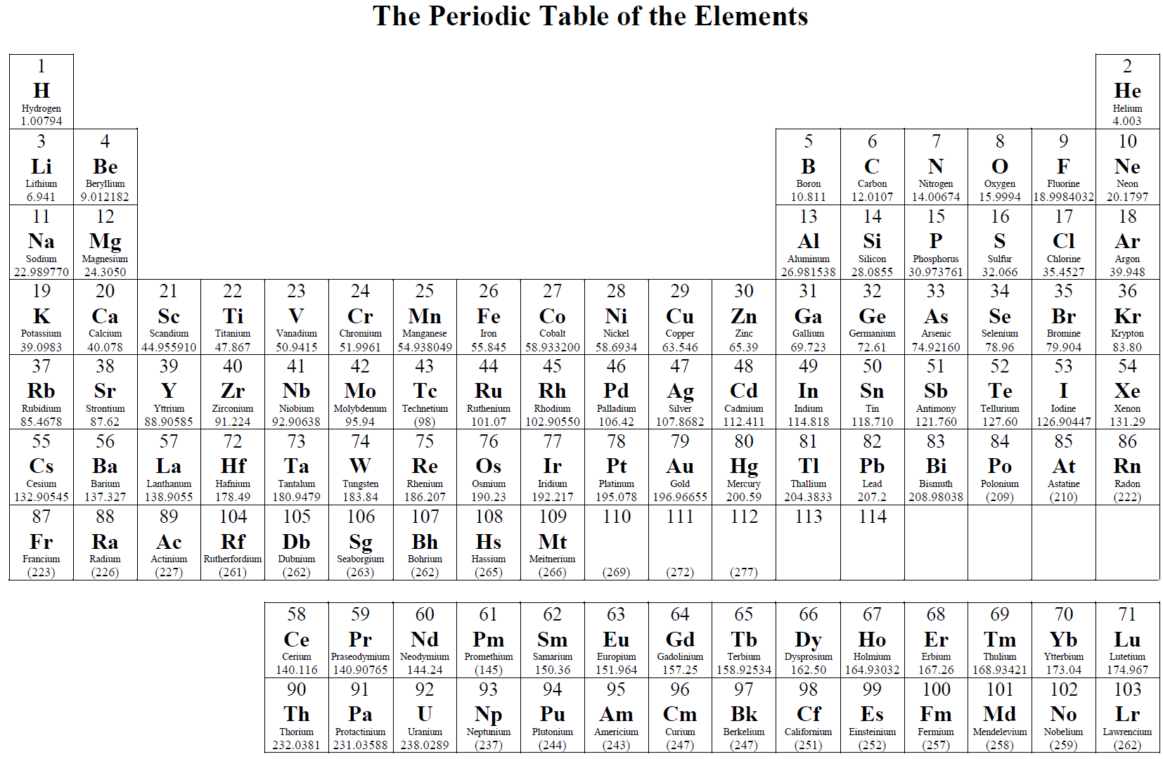
Groups and Organization

Slide 13
Compounds
A compound is a collection of many atoms
They may be a single element or different elements
Ex The following are diatomic molecules.
You must memorize these!
Ex What elements are present in the following compounds?
a) CoCl₃ b) NaHCO₃ c) SiS₂

Slide 14
Compounds
Identify all elements and the number of atoms of each.
a) CuCl₂ b) Al₂(SO₄)₃
Ca(OH)₂ d) (NH₄)₂Cr₂O₇

Slide 15
Compounds
We can predict new compounds based on families
Ex Aluminum oxide has the formula Al₂O₃. What are two other possible aluminum compounds?
Ex Given the following compounds, give eight other possible compounds based on the families.
a) KCl b) MgCl₂ c) H₂O

